Slide 1

Welcome to the 6th Annual POPCORN 101
Popcorn Season Fundamentals for Unit Kernels, Committee Chairs, Treasurers, and anyone interested in the wonderful world of all things popcorn!

Slide 2
Objectives
Who’s my Kernel? What district am I in? (Where am I?)
Why do we sell?
Understanding the budget and its role in popcorn sales
Before the corn (behind the scenes)
Popcorn arrival date, then what?
Personal sales types
How to set up and conduct a Show and Sell
Information for families. Leading a popcorn kickoff/taste testing event
How much popcorn should I order?
Accepting credit cards and electronic payments
Tools available (Apps, FB page)
Unit incentives
Importance of communication within Popcorn Chain of Command. (Unit Kernel, District Kernel, Council Kernel, Popcorn Staff Advisor, Associate Popcorn Staff Advisor)

Slide 3
Who is my Kernel?
District Borders
What district am I in?
What’s a district?
Tidewater Council serves Norfolk, Virginia Beach, Portsmouth, Chesapeake, and northeastern North Carolina.
The council is broken down into 4 districts:
  Princess Anne- VA Beach south of I-264
  Bayside- Norfolk and VA Beach north of I-264
  Three Rivers- Chesapeake and Portsmouth
  Albemarle- NC (Camden, Chowan, Currituck, Gates, Dare, Pasquotank, and Perquimans Counties)
Districts are made up of units- Packs, Troops, Ships, Crews, and Posts

Slide 4
District Popcorn Kernels
Albemarle
Mary Perrine
Mary.Perrine@scouting.org
540-718-2797
PA (Popcorn Army)
Tony Montemurno
kerneltbaloney@gmail.com
757-635-0676
Matt Conway
19mconway84@gmail.com
757-510-6137
Kelley Starnes
JKStarnes2014@gmail.com
412-491-4849
Three Rivers
Rudy Nimmo
vtccgolf@gmail.com
540-230-7507
Clark Walters
crazyscout94@gmail.com
757-560-8647
Tammy Walters
crazybear127@yahoo.com
757-559-3726
Bayside
Scott Gilmore
Esgilmore@hotmail.com 703-372-2059
Krista Dunn Krista.dunn1621@gmail.com757-339-0609

Slide 5
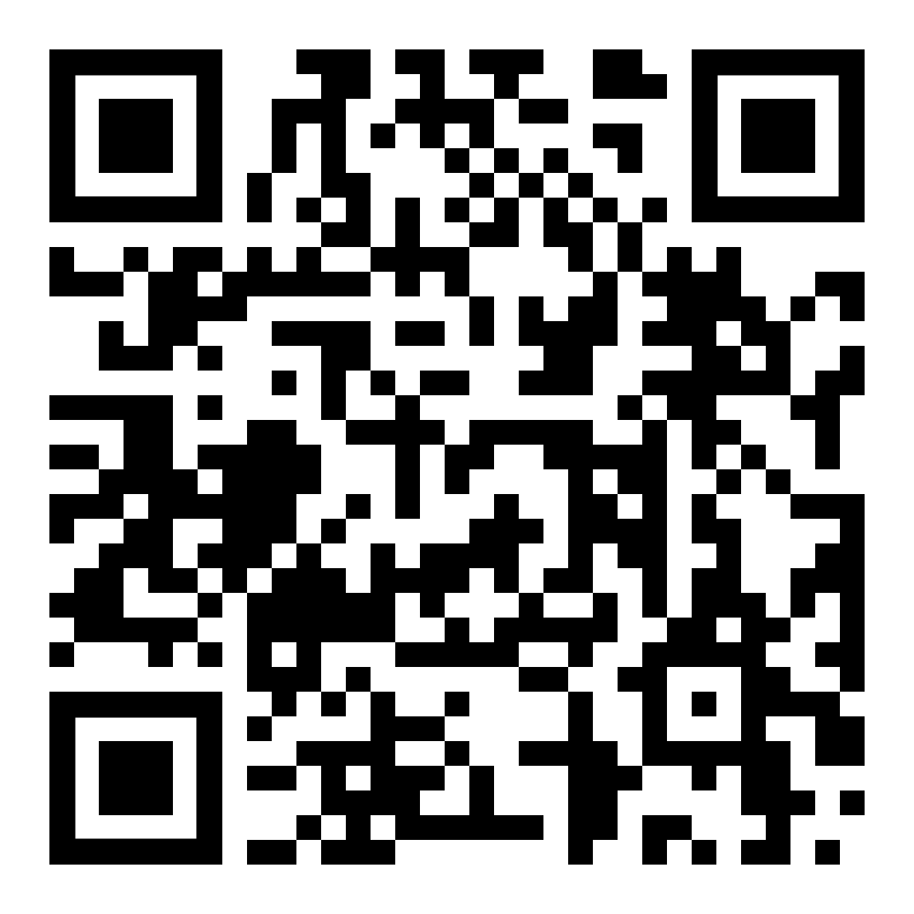
Council Popcorn Personnel
https://tidewaterbsa.com/2023popcornsale/
Council Popcorn Kernel
Erin Alger
erin@realresultsva.com
757-943-7226
Popcorn Staff Advisor
Alison Harrison
popcorn@twchelpdesk.raiseaticket.com
Popcorn Consultant
Pam Samples
pasamp42@gmail.com
Tidewater Council - Mary Jayne Breeden Council Service Center
1032 Heatherwood Drive, Virginia Beach, VA 23455
TidewaterBSA.com/popcornsale/2026popcornsale

Slide 6
Why we do it
Other Benefits of Selling
Raise money for unit activities and needs
  Highest commission in nation
Scouts earn prizes
Scouts build camaraderie
Scouts learn communication skills, salesmanship, and earning their own way
Build a foundation for Eagle project fundraising
Can earn advancement requirements

Slide 7
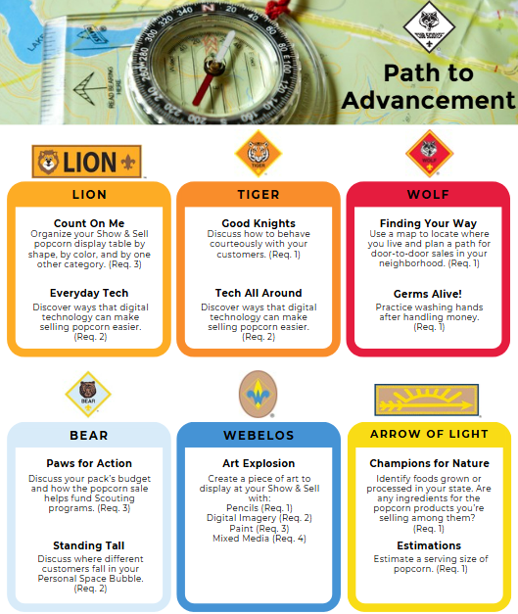
Cub Scout Advancement

Slide 8
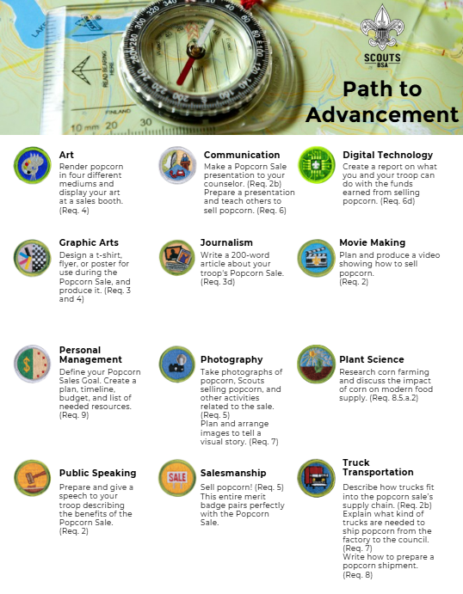
Scouts BSA Merit Badges

Slide 9
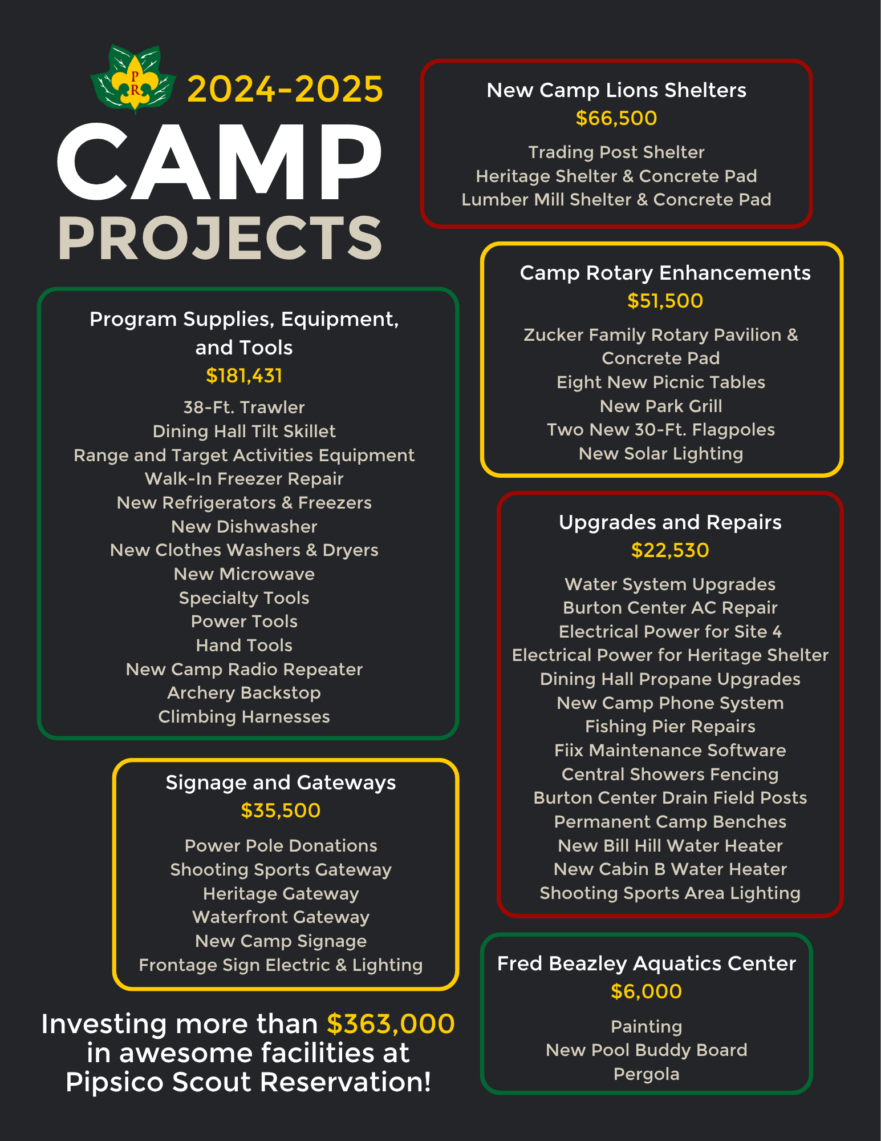
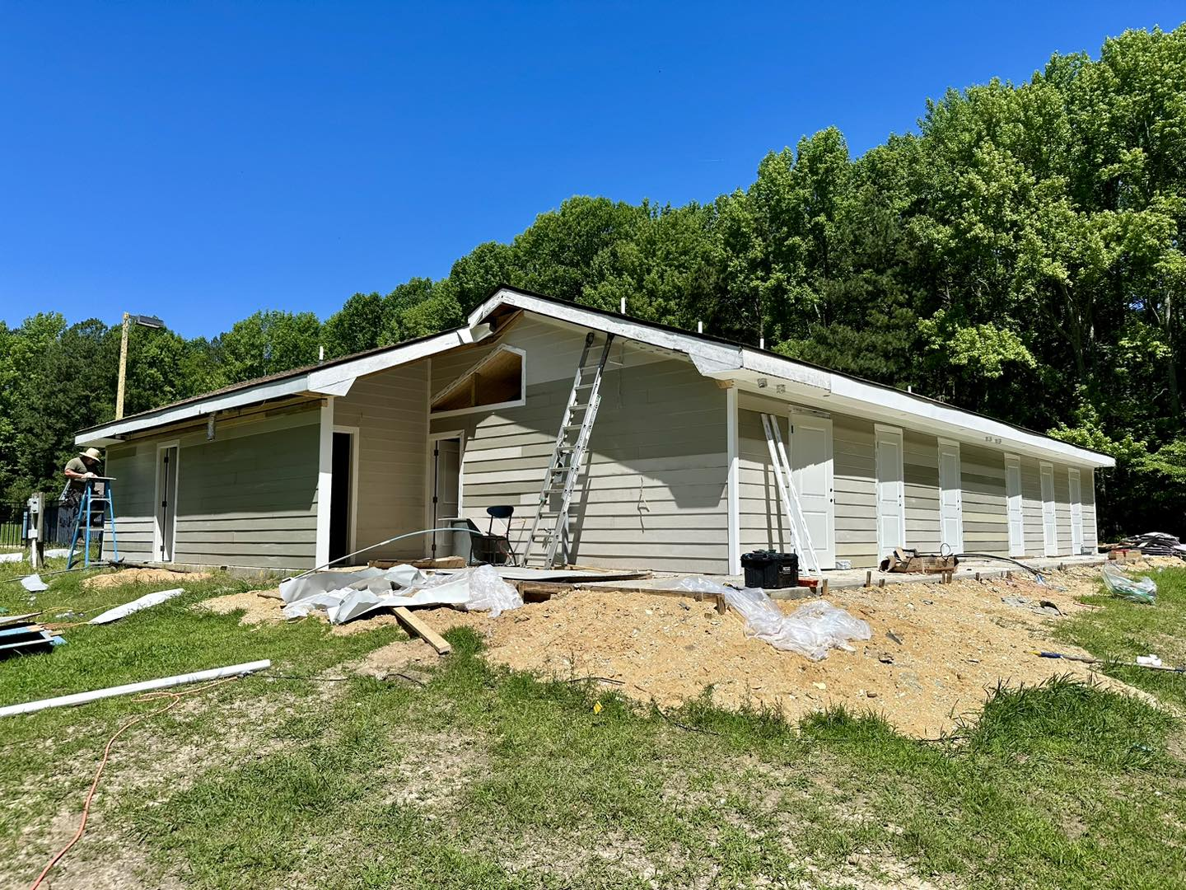
Council Benefits

Slide 10


Slide 11
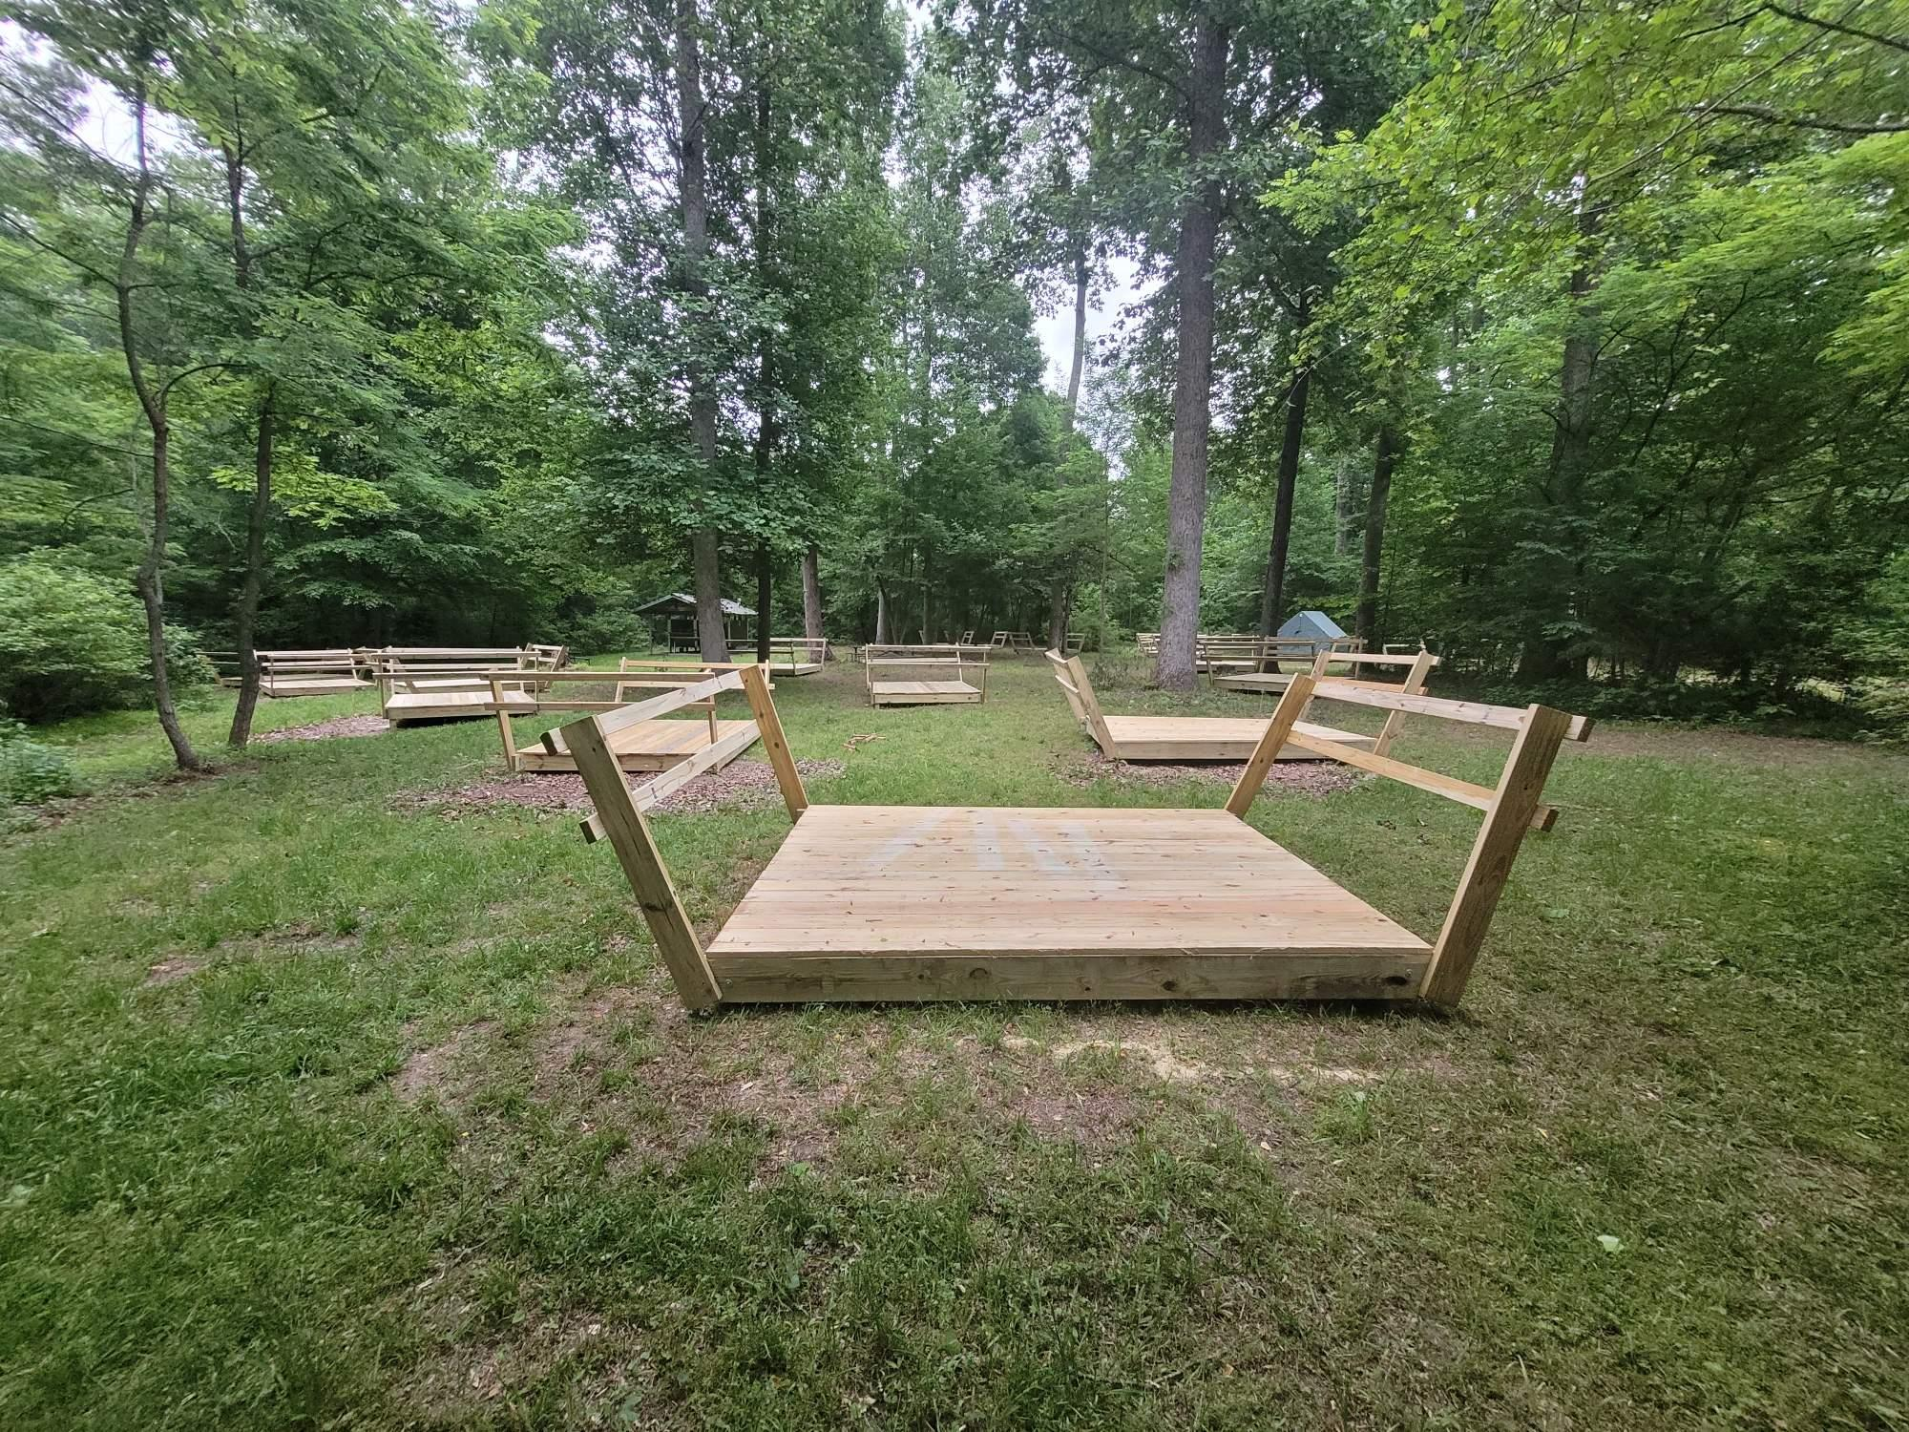
New tent platforms at Site 2

Slide 12
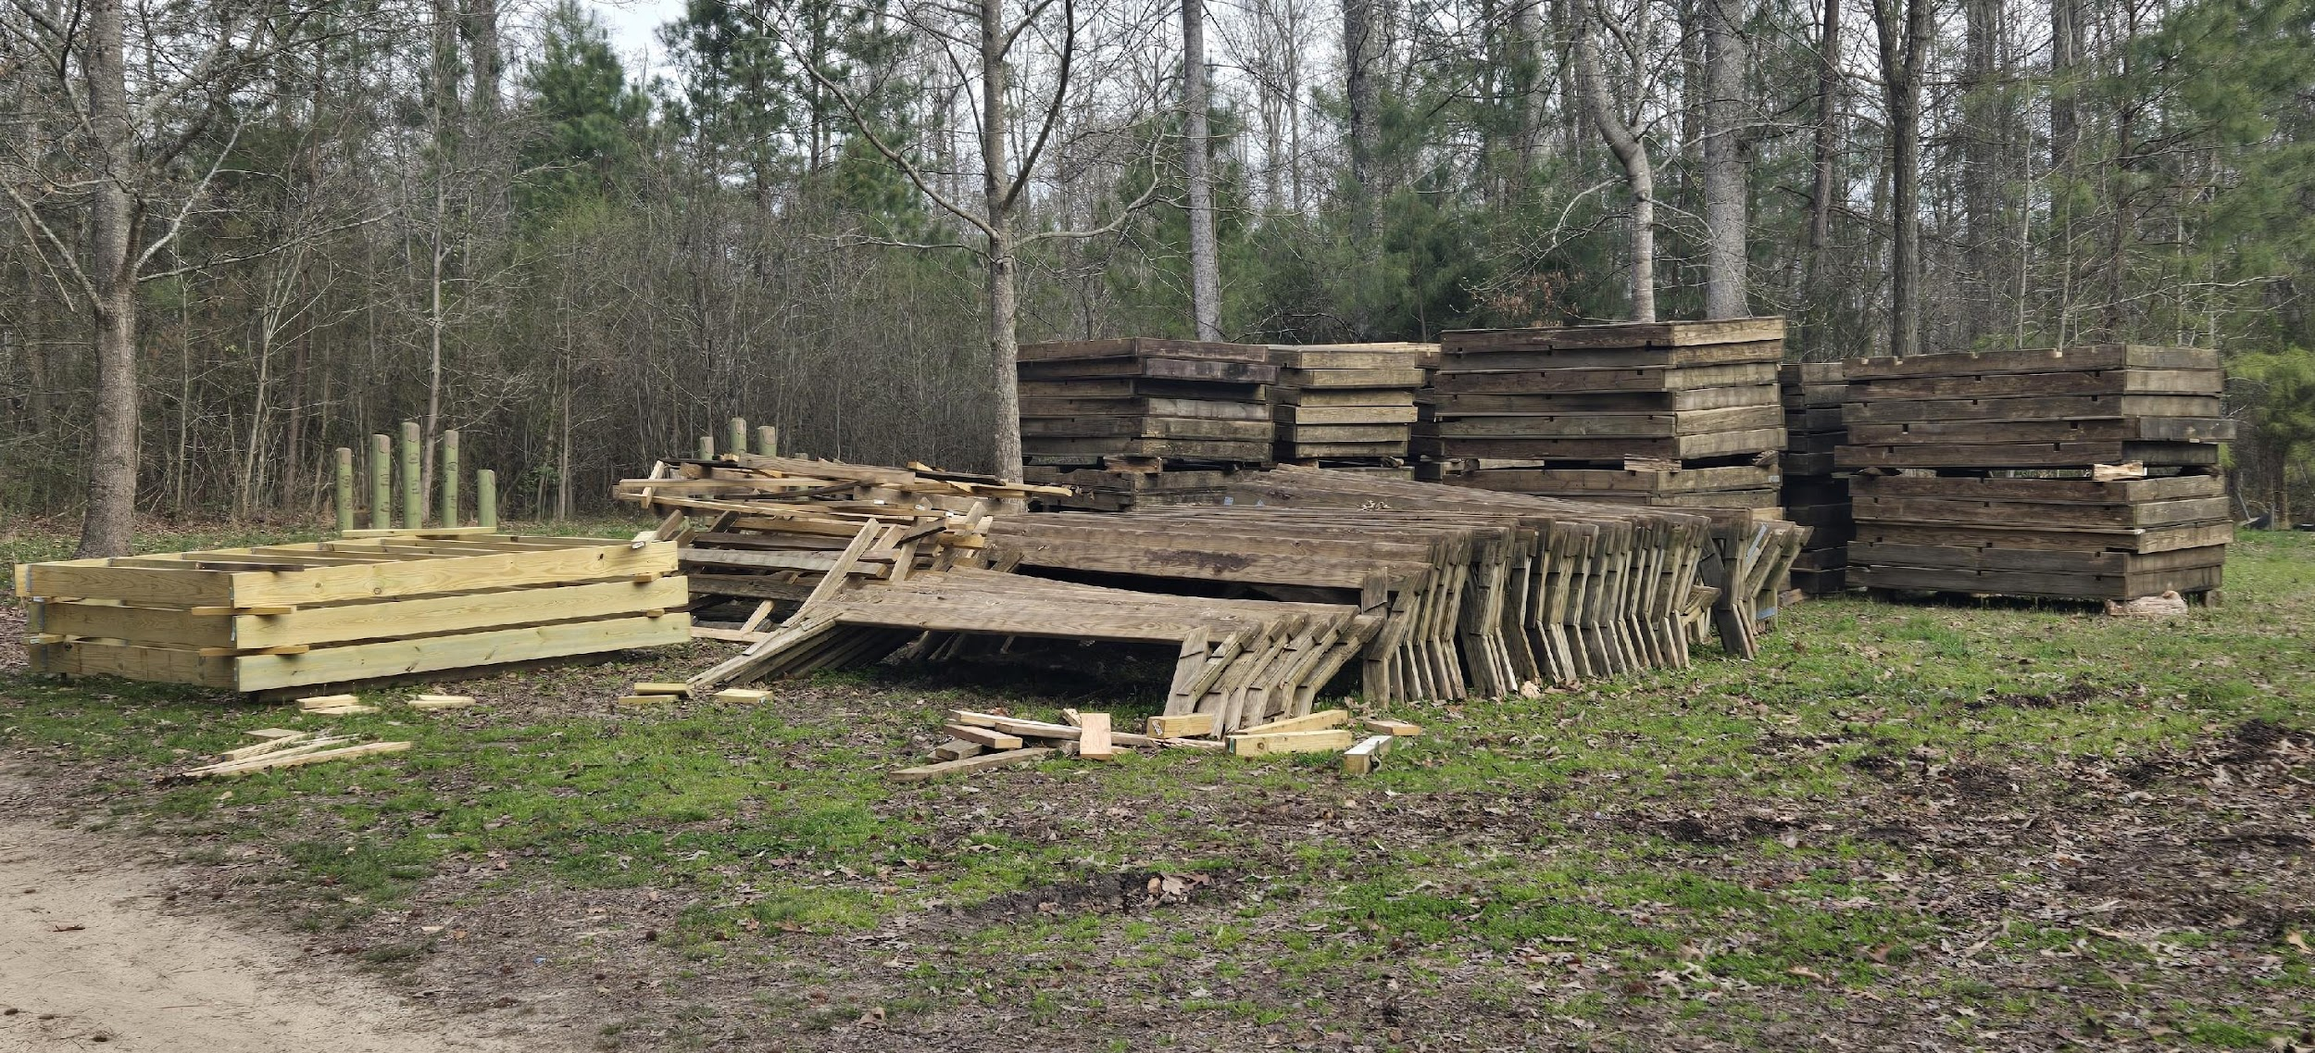

Slide 13
The Budget
Importance of the budget
  Covers unit activities and costs for the year
  Each Scout’s sales goal is based off the budget
  Parents want to know where their money goes
  Transparency of money flow
Many ways to format a budget and distribute earnings
  Pack Tiers
  -Identifies benefits at certain sales levels.
Popcorn Kernel-Treasurer-Committee Chair-Cub/Scoutmaster relationship

Slide 14
Before the Corn
Council leadership and Council Kernel meet with vendor to establish contract. (Feb-Apr)
Unit kernels start making their plan. (≈March)
101 Training (June)
Units establish their budget and sales goal. (Jun/Jul)
June/July:
  Aug Lowe’s dates released
July:
  Remaining Lowe’s S/S dates released
  Food Lion dates released
  Seasonal Training
  Units hold kickoff party
  -Kernel discusses plan and
  -Hands out supplies:
  Sign
    Money envelopes
    Order form
    Large unit money envelope
    Tasting kit
  Units submit their first order

Slide 15
Product Arrival
4 orders submitted ≈2 weeks prior to their arrival dates (key to our success?)
First Thursday in August Semi truck delivers 1st product order
-Helpers pick up product that day (vice making appt).
Subsequent orders arrive:
-Early September
-Early October
-Mid November
  Paid for in advance when ordered.
  All payments due.

Slide 16
Personal Sales
  Door to door
    Best to have product in hand but not required.
    If the product will be delivered later, provide a clear delivery timeline.
    Keep the chocolate products cool.
  Take order form to work
  Friends, neighbors, local family members
  Online (30% Commission) http://www.prpopcornstore.com/
    Kernel establishes account for each Scout pecatonicariverpopcorn.com
    Include these sales for Scout’s prize total
    Free shipping
    Daily Online Summary Email Notification

Slide 17
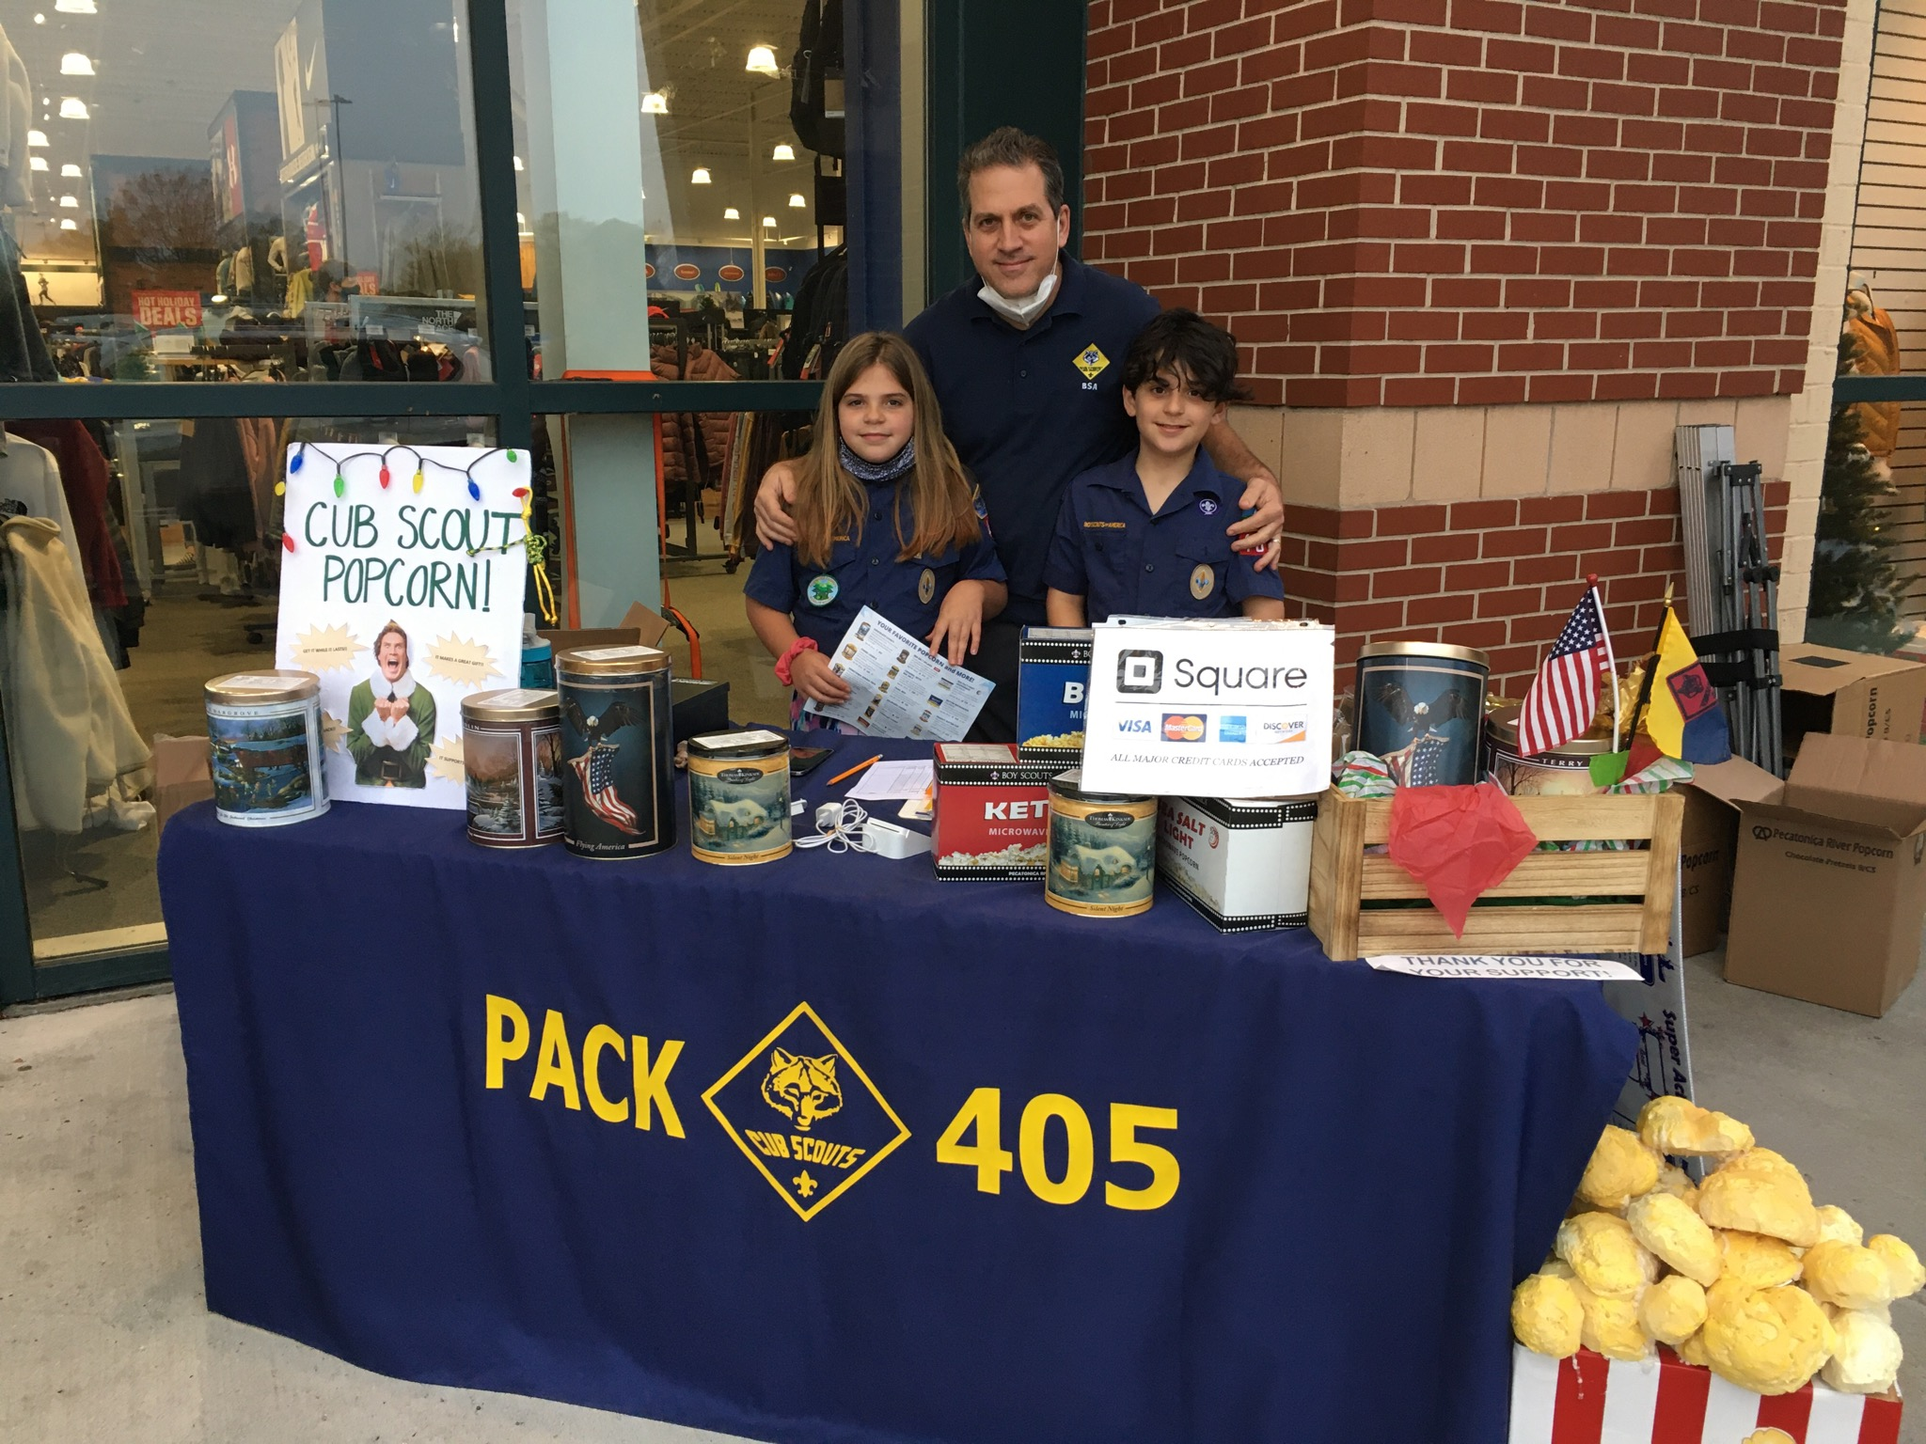
Show and Sells
Selling in front of a business, at an event in public, etc.
Talk to store/event manager to set up
  Have proof of booking confirmation and resolve conflicts professionally.
  Understand and follow THEIR rules
  Lowe’s first shift for the day, check in with the return desk
Ask parents for places where they might have connections
Cubs work in pairs with 2 parents
Certain companies restricted (Home Depot, Wawa, etc.)
Break out the bling (Unit flag, tablecloth, homemade décor, etc.)
  Keep chocolate products cool
  Bring membership flyers/joining information
Have a S/S notebook with several order forms to show product, a tracking sheet and money envelope for each shift, money box with petty cash ($100), and credit card device/app.
Tell parents to periodically verify inventory throughout the sale. Scout’s sales can get lost if cash/credit sale is not documented correctly.

Slide 18
DO’s and DOn’ts of DOnations
  DO: Personal donations DO count as a sale (40% commission). Add them into the Scout’s total sales.
  Don’t: Units shall not ask for donations. If asked by the customer, “Do you take donations?” a proper response would be, “Donations will provide popcorn to support the military community.”
  Don’t: Have your donations container out and advertising itself at S/S.
  DO: The “military donation” is a sale item on the order form and can be sold as such. Point it out to the “I don’t eat popcorn” folks.
  ALL donations are reported to “buy” any returned products, which are then donated to the USO.
  Just like their sister sales, online donations provide a 30% commission.

Slide 19
Popcorn Kickoff Party
Plan for this with your unit before submitting your first order, preferably. Find out if parents want extra product for door-to-door sales, taking order form to work, etc. (i.e., take-orders)
Have your selling strategy in place prior to meeting
*STARTING EARLY IS THE KEY TO SUCCESS*
Form a Popcorn Crew based on unit size (Kernel, Treasurer, S/S crew, Inventory crew)
Do taste testing
Make it fun for kids (Cubs) and informative for parents
Use the Popcorn Guide as your reference
Discuss what Scouts should say to customer (Cubs)
Discuss use of show and sell tracker and credit card app (Load it now)
Will Scouts get credit for their shift, or all Scouts split the day??

Slide 20
More Important Information for Parents
Track items checked out to families (receipt book, text, etc.)
30 days to sell it or return it. MAKE SURE THEY UNDERSTAND
  “Returns” are a financial loss to the council if not sold or donated. They do NOT get returned to the popcorn company.
Maintain neat records. Proof of sales required for Winner’s Circle prizes.
Popcorn Kernels need to submit their order (x4) based on the unit’s plan:
  Contact parents for their personal orders before each order is placed to ensure an adequate supply is on hand for show and sells planned during each time frame
  Do not tap into Show and Sell stock to satisfy take-orders unless necessary. Utilize unit-to-unit transfers.

Slide 21
“How much should I get?”
Look at what was sold last year. Are same Scouts selling this year?
  Your unit’s history will be accessible to you on Scout Boss
Base it on YOUR plan:
  What Show & Sells are scheduled?
  Which parents want to walk the neighborhood with their Scout?
  Do parents take order forms to work?
Have funding in unit’s bank acct to cover 60% of total retail for 1st order
Plenty of opportunity to sell off first order. (4 orders total)

Slide 22
“How much should I REALLY get?”
$10 Classic Caramel is always the biggest seller.
  2025 council sales ≈ 25%
Caramel with Sea Salt another favorite
  2025 council sales ≈ 9% (then Cheddar, Pretzel, Cinnamon Roll)
Pick up all flavors and at least 1 of each of the top 3 non-returnables. You’ll sell it or transfer to another unit.
  Cheese and Trio usually returnable for limited time
  Chocolate Lovers is not returnable
When in doubt, talk to your District Kernel for guidance.
**NOTE**Keep chocolate products cool (Choc. Lovers, Pretzels, Peanut Butter Cup, etc.). Store in house, not garage. Products are subject to the infamous thunk test upon return.

Slide 23
Using Credit Card Apps
Utilize unit EIN and name on bank account (not your personal info) when establishing your account (1099-K)
  For more info, Fiscal Policies and Procedures for Scouting America Units
  Scouting America does not endorse any credit processing vendor.
Different phone connections or Bluetooth
App company takes their cut
Card info can be inputted manually (add’l fee)
Review transactions on your app at the end of the day to verify your S/S sales.
More info on Pecatonica website.

Slide 24
Communications and Tools
Sign up on Tidewater Council Popcorn Kernel FB group.
  Lowe’s release dates, product swaps, real time updates, etc.
  If you are not a Facebooker, get someone old from the unit who is
Keep district and council informed of plans for excess inventory
Don’t order more if you have a large enough surplus for planned sales. Exchange with other units.
Scout Boss: Pecatonica’s site to manage the popcorn sale, located at https://pecatonicariverpopcorn.com/
Build or acquire a sales/inventory tracker
Notify parents of their Scout’s credit after S/S. They can add a line item to their Scout’s order form to document their Scout’s credit for each S/S event.
  Documentation of each Scout’s sales will be required for Winner’s Circle Prizes
Pay on time. Report donations throughout the sale by deadlines to help Scouts earn recognition items.
Sign up on Tidewater Council Popcorn Kernel FB group.

Slide 25
Unit Incentives
Use tier method to fund expenses like registration, summer camp, etc.
Budget for unit prizes for certain sales goals in between council prize levels (e.g., $250, $750, $1,500)
  Grab bag
  Pizza party for unit goal
  Pies in the face (use paper plates vs good China)
  Unit T-shirts/hoodies
  Day Camp/Summer Camp registration

Slide 26
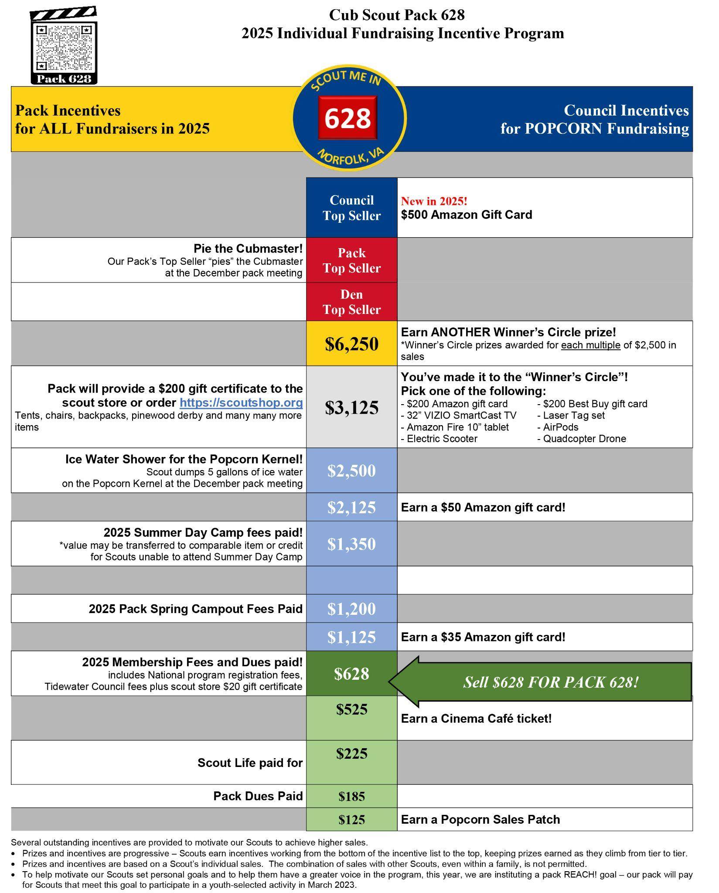

Slide 27
Show and Sell Tracker
Shift number | Date and time |  |  |  | Scout #1 Name | Scout #2 Name | Scout #3 Name
Product | Price | Previous shift's ending inventory | Your Shift's Starting inventory | Any items added mid-shift | CASH SALES | CREDIT SALES | Anticipated Ending Inventory | Actual Ending Inventory |  | Total Number of each item Sold | Total dollars of item sold | Cash Collected | Credit Card Sales | Notes
 |  |  |  |  | Tally marks for each item sold | Tally marks for each item sold | Initial inventory + Added inventory - Number sold | Should match previous column numbers |  |  | Unit price times number sold |  | Total Dollars charged to credit card
Choc Lovers | $55
Cheese Lovers | $45
Classic Trio | $35
Maple Pecan | $30
Micro Double Butter | $30
Chocolate Pretzel | $25
Peanut Butter Cup | $25
Sea Salt Splash | $25
Caramel Sea Salt | $25
Trail Mix | $20
Jalapeno | $20
Cheddar | $20
Micro Kettle | $20
Micro Butter | $20
Cinnamon Roll | $15
Classic Caramel | $10
Total Sales in dollars for your shift |  |  |  |  |  |  |  |  |  |  | Sum of column above $_______ | Total Cash Collected for sales (Sum of column above) = $_______ | Total Credit Card Dollars Collected for sales (Sum of Column above) $__________ | Sum of Credit Cards + Cash for sales (should match Total Sales Box) $_________
Total Dollars in Donations collected for your shift |  |  |  |  |  |  |  |  |  |  | $____________________

Slide 28
Personal Tracker
Flavor | Price per | # sold | total sales | 40% profit | 60% owed to council |  | PERSONAL SALES |  |  |  |  | SHOW-N-SELL SALES |  |  |  | ONLINE SALES |  | Email Date
Chocolate Lovers | $55.00 |  | $0.00 | $0.00 | $0.00 |  | Date paid | Amount | Donation | Notes |  | S/S date | Sales | Donations |  | Online Sales | Online donation
Cheese Lovers | $45.00 | 1 | $45.00 | $18.00 | $27.00 |  | 3-Aug | 35 | 2 |  |  | 1-Sep | 150 | 24
Classic Trio | $35.00 |  | $0.00 | $0.00 | $0.00
Maple Pecan | $30.00 | 2 | $60.00 | $24.00 | $36.00
Double Butter | $30.00 |  | $0.00 | $0.00 | $0.00
Chocolate Pretzel | $25.00 |  | $0.00 | $0.00 | $0.00
Peanut Butter Cup | $25.00 |  | $0.00 | $0.00 | $0.00
Sea Salt Spalsh | $25.00 |  | $0.00 | $0.00 | $0.00
Caramel Sea Salt | $25.00 | 3 | $75.00 | $30.00 | $45.00
Trail Mix | $20.00 |  | $0.00 | $0.00 | $0.00
Jalapeno | $20.00 |  | $0.00 | $0.00 | $0.00
Cheddar | $20.00 |  | $0.00 | $0.00 | $0.00
Micro Kettle | $20.00 |  | $0.00 | $0.00 | $0.00
Micro Butter | $20.00 |  | $0.00 | $0.00 | $0.00
Cinnamon Roll | $15.00 | 2 | $30.00 | $12.00 | $18.00
Classic Caramel | $10.00 | 5 | $50.00 | $20.00 | $30.00
Total |  | 13 | $260.00 | $104.00 | $156.00
Total sales | $185.00
Total donations | $26.00
Grand Total | $211.00
 |  |  |  |  |  |  |  | 35 | 2 |  |  |  | 150 | 24 |  | 0 | 0

Slide 29
In Summary. . .
The total sales required is based off a working budget
  https://www.scouting.org/programs/scouts-bsa/troop-resources/program-planning-tools/
Help unload shipment when you can
Hold a kickoff party
Start early
Manage your inventory
Diversify your selling strategy
Communicate, Communicate, Communicate

Slide 30
QUESTIONS?

