Slide 1

Cub Leader Backpack to Retention
“The Great Dino Roundup”

Slide 2

FALL RECRUITING PLAN
Great Dino Roundup Expedition Plan
Council-Provided Recruiting Incentives and Support
Timeline for Fall Recruiting

Slide 3
Expedition Plan
Theme: “The Great Dino Roundup”
Build a team
Generate excitement
Train your volunteers
Coordinate with your District Key 3
Be present at key events
Be organized with information, sign-up options, unit calendar, and GREAT introductory meetings (for Scouts and parents)

Slide 4

Joining incentives
$12 Program Fee discount for new Scouts (online or paper application)
Dinosaur excavation egg
Free Saturday pass for District Dino themed event
New Parents Guide
Welcome kit that includes car magnet, sticker, Scout Life mini-mag, peer to peer recruiting card
Military registration fee waiver.

Slide 5

Recruiter incentives
Every Scout that brings a buddy and the buddy signs-up, the Scout will be entered into a drawing.
Each district will hold their own drawing for a Lego dinosaur kit or family four pack of tickets to the Virginia Living Museum.
Winners will be drawn on December 10, 2026.

Slide 6

Unit Recognition
Raise the Tide Membership Challenge:
Achieve 1.5% or greater net membership growth
and
Achieve 68% or greater youth retention
Recognition
Guidon ribbon
Unit Leader and NMC golf shirt

Slide 7


TIMELINE
May |  | June |  | July |  | August |  | September |  | October
Fall Leader kickoff
Unit recruiting booths at school "Open Houses"
DE's set School visits and Join Scouting Nights with Principals, coordinate with units
DE School Visits
Recruit at Join Scouting Nights
Units complete annual budgets, calendars, and pack recruiting worksheet
Units conduct "Back to the Pack" events
Pack/Troop orientation after
Join Scouting Nights
New Scouts / families attend
Cub-o-rees
and first GREAT Den/Troop meetings

Slide 8
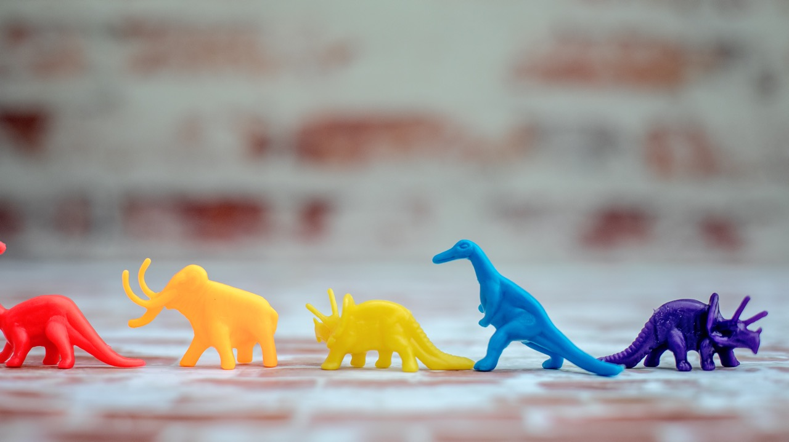
Dig Site 1: Your Unit and Leadership Health
Conduct a den, pack and leader inventory
How to fill leader vacancies

Slide 9

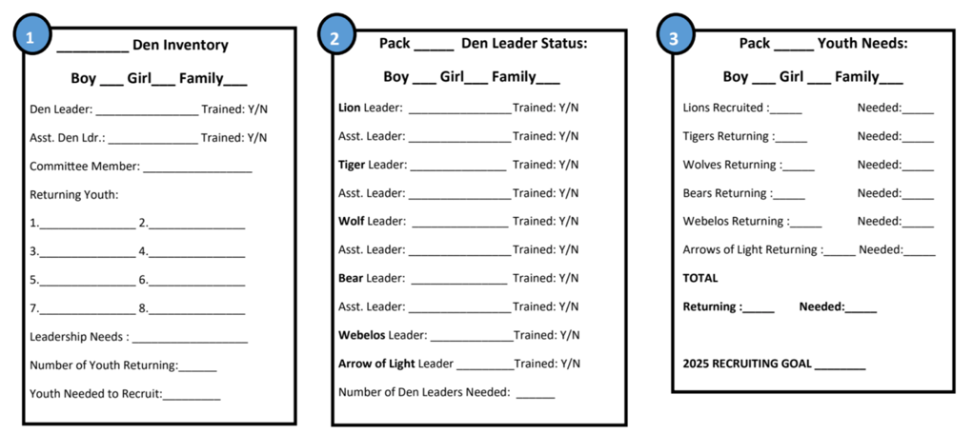
Den Inventory
Pack Committee and Leadership
Cubmaster * Committee Chair * Pack Committee (including a designated treasurer)
New Member Coordinator * Popcorn Kernel

Slide 10
Recruiting Leaders
Talk to parents face-to-face. Ask them to volunteer!
Give them a job description and expectations of the position (use Council and Scouting America resources…none of these jobs are new!)
Provide them with a mentor!
Provide them with the dates of in-person training and encourage them to attend.
Follow up on how they are doing and what questions they have.
Tell them “Thank You”

Slide 11
Key leadership roles
Cub Master
Committee Chair
Den Leaders
New Member Coordinator
Committee members (**Treasurer)
Popcorn Kernel

Slide 12

Dig Site 2: The New Member Coordinator (NMC)

Slide 13
What do NMCs do?
Often the first “official” contact a prospective parent has with a unit
Maintain and use your units Invitation Manager tool on my.scouting.org
Helps coordinate a scout’s first meeting
Answers* parent questions about scouting, including:
  How to join
  Meeting times
  Costs/Fundraising
  Uniforms
  Parent involvement
  Calendar
*A NMC may not have all the answers
but they should know who to ask to get them

Slide 14
Why do we need an NMC?
Every unit has a NMC or 5 already. If you or your units leaders share these jobs then you are all playing the role of NMC in addition to your registered position.
Main point of contact for new families and recruitment opportunities
The welcoming face at the door, READY to INVITE new parents to sit down and ask questions at meetings
Helps answer questions about scouting and the specific unit
Helps the unit’s overall retention rate
Helps families find another Scouting Unit if your units schedule doesn’t work for them
Part of the unit committee – provides insight into parent questions and concerns

Slide 15
Qualities of a good NMC
An adult that has no problem speaking with new families
Friendly, outgoing, and bubbly people who have conversational charisma are ideal
They have at least some prior knowledge of Scouting or have ~6-12 months of experience in a unit
Knows basic methods and details about the unit they are in
An active member of the committee
If you can plan a kids birthday party with school friends then you can plan a recruiting event
Should be organized and have a clean welcoming appearance

Slide 16
NMCs and Recruitment
NMCs can help coordinate recruitment opportunities at events like:
Joining night
Bring a friend night
Church
Sporting events
Open House / PTA / school events
Festivals or community events
Fundraising events
Community service projects
Anywhere you have the ability to wear your unit t-shirt or uniform
District or Council hosted recruiting opportunities

Slide 17
NMCs and Retention
NMCs can help keep Scouts and Leaders in the unit by:
Keeping an eye on attendance to identify people who are beginning to fade out
Communicate (preferably in person) with families who are either fading out or have been absent for more than a month straight
Help get the family re-engaged and if necessary offer assistance in rehoming the family with another unit that fits the families schedule better. (this is not YOUR Scout, they are OUR Scout)
Listen to concerns, keep an ear out for challenges that new and existing families express and relay them to the Committee
Use Family Talent Survey annually for all member families/adults

Slide 18
Ready to join the Team? Here’s how!
Take your Safeguarding Youth Training
Register as a Committee Member with the Unit
Complete your New Member Coordinator and Committee Member Training online or in person when available at University of Scouting or a District Training Day
Attend monthly District Roundtables for the latest recruiting resources and for networking with your District Membership Chair

Slide 19
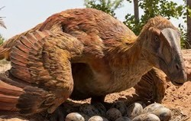
Dig Site 3: Build your ideal year of scouting (Calendar)
What does an ideal year of Scouting look like?
Reference council, district, school, and community calendars.
Do a start, stop, and continue of last years calendar.
Collect information on events or places the unit wants to go.
Involve your parents and Scouts – have your den leaders get input and provide it back to the “calendar committee”
Be deliberate about the cost of your events / total program cost to families
Are you “keeping the promise” of how you sold your unit program?

Slide 20
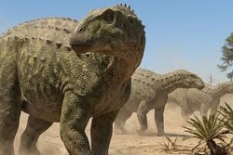
Finance your “Ideal Year of Scouting” (Budget)
Set fundraising goals for Popcorn and Camp Cards
Get the right people-power
(many hands make light work)
Key dates and resources

Slide 21
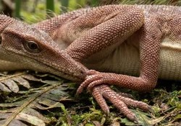
Dig Site 4: Back to the Pack
Who: Everyone in the unit, to include non-renewed families
What: A night of fun-filled and information-filled activities
When: Schedule in late summer, after camps and vacations, and right before school starts again
Why:
  A reunion for active families
  An on-ramp for inactive members who you may want to return
  Showcase what you’ve done, talk about what you’re going to do
  Infuse energy into the program for the new Scouting year
  A high energy and well-organized event will build retention, and energy for your pack
How: slide shows, calendars of events, crafts, service project highlights

Slide 22
“Back to the Pack” night
Contact “lapsed” scouters – personally invite them to come back
Get your Scouts and families excited about the Scouting year ahead
  Hand out the Pack’s Calendar of Events for the year
Plan a fun program
  Ice cream social /watermelon feast
  Carnival games and sports
  Videos / picture board of past year’s activities
  Display of past year’s crafts / pinewood derby cars
Recruit volunteers for unit events / leadership roles
  Family talent surveys
  Face-to-face
  Emphasize the results

Slide 23
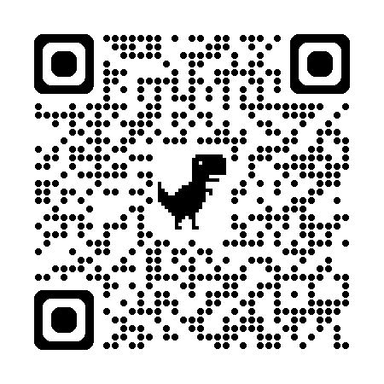
Dig Site 5: Unit Marketing Plan
www.scouting.org/recruitment/
Review & update your BeAScout.org pin monthly
Gather existing & build new resources
Review older resources for alignment
Network anywhere your family goes
Encourage wearing unit t-shirt to school
Recognize and celebrate each Scout who recruits or brings a friend to a meeting even if they don’t join

Slide 24
Build Unit Digital Resources
Public facing social media profile with contact info and general unit details. Post regularly as events take place
Unit Logo
Review & update your BeAScout.org pin monthly
Official Unit email address with signature
Digital communication method for unit with living calendar (members only)

Slide 25
Build Unit Tangible Resources
Trifold with images of recent activities and outings
One page calendar for the current/upcoming Scout season listing the schedule at least at a high level
Welcome to Scouting Guide specific to your unit
New family checklist
Unit business cards
Uniform checklist
Family Talent Survey
Expectations and/or Code of Conduct agreement

Slide 26
Scout Joining Night ^{(managed by NMC)}
Make a simple agenda that flows
Coordinate with Den/Patrol leadership for ideas & staffing
Have a plan for communicating with each family that walks in. Packet of papers, QR code for online resource, or mix
Set up trifolds or slide show with the latest information
Promotion of “Keep the Promise” and other unit events that new families can jump into and feel the fun of Scouting

Slide 27
A.B.R. – Always Be Recruiting
EVERYONE IS A RECRUITER!
Review & update your BeAScout.org pin monthly
Keep these on hand all year long
  Unit Information Sheet / Welcome guide
  Unit business cards
  Recruiting Patches for youth/leaders who recruit
  Paper applications with blank medical forms
Use the Pack/Unit Recruiting Worksheet as a basic starting point

Slide 28
2026 Pack Recruiting worksheet
Goal Item | Completed | Action Item
1 |  | Recruit one or more new member coordinators to head up your recruiting and welcoming efforts.
2 |  | Conduct a Leader Inventory to determine den leader vacancies. Recruit new den leaders during the summer where possible.
3 |  | Hold a “Back to the Pack” event with your pack. Contact your current and past Scouting families to a fun night of activities and a preview of the fun to come.
4 |  | Create a Pack Information Sheet that includes contact information for current leadership, your program calendar, and any important general information new parents will want to know. This will be required to be permitted to participate in Join Scouting Night.
5 |  | Attend the Fall Recruiting Orientation at your August Roundtable
6 |  | Update your pack BeAScout.org “pin”.
7 |  | Hold a Join Scouting Night at your assigned elementary school on the night arranged by your district executive.
8 |  | As a pack or with another area pack, hold an outdoor, activity packed Open House to bring new families .
9 |  | Schedule your Parent Orientation and first den meeting for the week after your Join Scouting Night.
10 |  | Choose your own promotional idea!

Slide 29
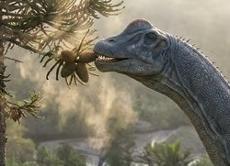
Dig Site 6: School-Focused Recruiting
Agenda Overview
Unit preparation
Joining incentives
Keeping the Promise
Mistakes not to make

Slide 30
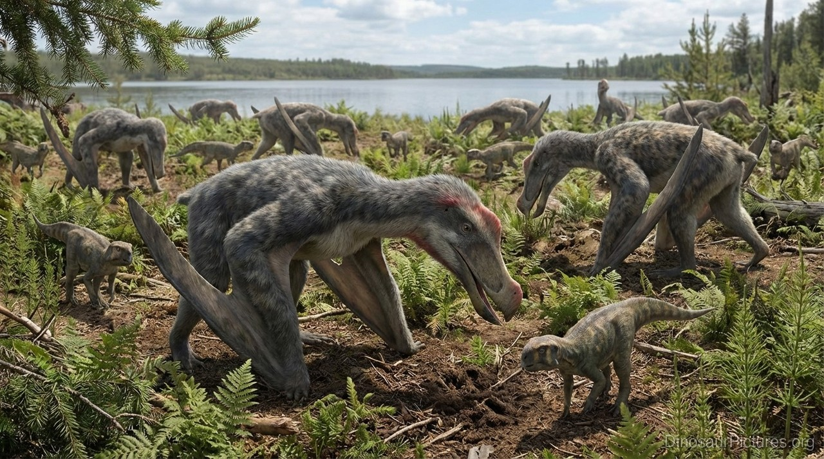
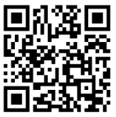
Dig Site 7: Resources for Success
Council and District Membership Committee
Unit and Council Commissioners
Council Professional Staff
District and Council Events
Council and Online Training
Online Resources
Activity Survey ->

Slide 31
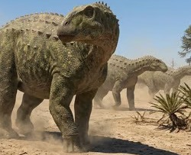
CUB CAMPING OPPORTUNITIES
Dinotopia Day Camps and Twilight Camps
Cub Scout “Pool Party” at Pipsico Scout Reservation
Air-O-ree
New Scout Field Day

Slide 32
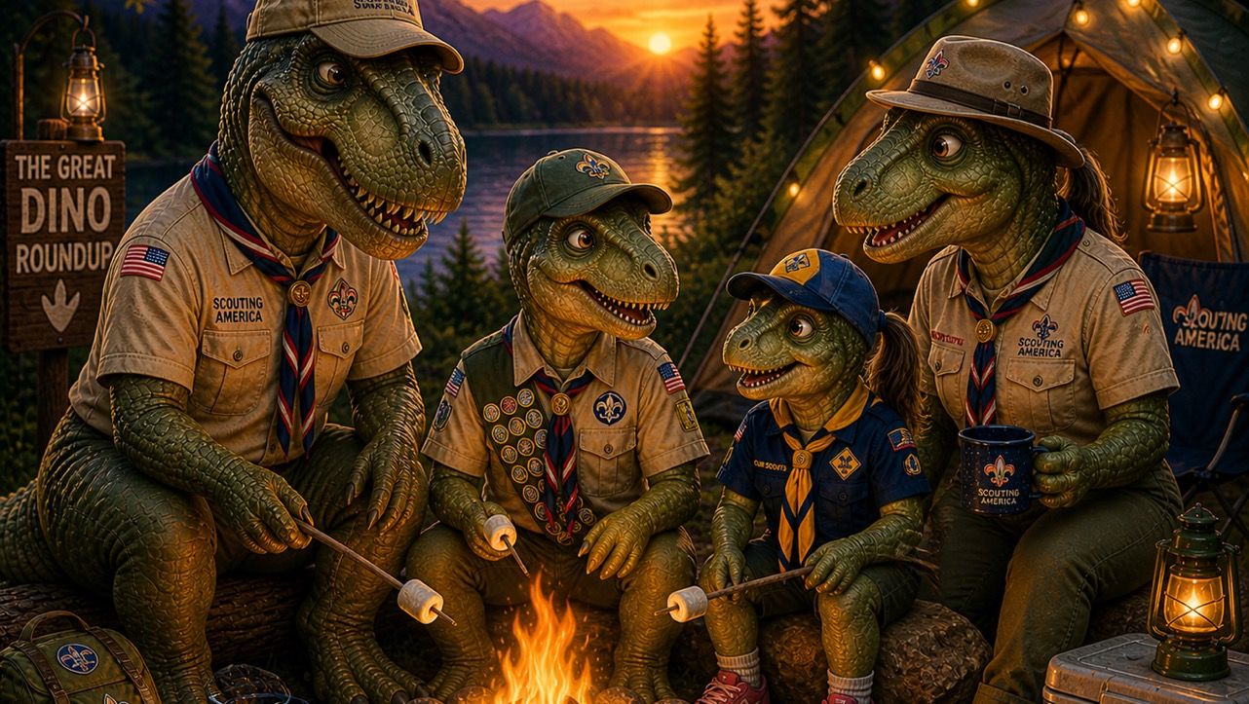
SCOUT EXECUTIVE MINUTE

