Slide 1
get ready for POPCORN 2025….

Slide 2
WHY SELL POPCORN?
HELPS PAY FOR DUES & REGISTRATION
HELPS BUY COOL THINGS FOR YOUR UNIT
HELPS A SCOUT DEVELOP PEOPLE SKILLS
HELPS WITH ADVANCEMENT & MERIT BADGES
YOU GET COOOOOOL PRIZES!!!
YOU LOOK COOL IN UNIFORM
YOU CAN ATTRACT OTHER COOL KIDS TO JOIN SCOUTS TOO!
SUPPORT LOCAL SCOUTING
HOW TO GET STARTED:
SIGN UP FOR SHOW AND SELL LOCATIONS
SELL TO NEIGHBORS AND FRIENDS
SELL ONLINE (ADD SCOUTS FROM UNIT ROSTER)
IMPORTANT: READ THROUGH THE POPCORN BOOK (NOT EVERYTHING IS INCLUDED IN THIS TRAINING)

Slide 3

A portion of proceeds from popcorn sales helps provide much needed upgrades to OUR camps.
Popcorn is a win/win for units and council.

Slide 4
HOW TO BE SUCCESSFUL IN 2025
DEVELOP A UNIT SALES PLAN & PRE-ORDER FOR YOUR UNIT (FIRST ORDER DUE BY WEDNESDAY, JULY 23 AT MIDNIGHT)
TRADE PRODUCT WITH OTHER UNITS
SUPPLEMENT YOUR STASH IN BETWEEN ORDERS
MANAGE YOUR LOCATIONS EFFECTIVELY. DO NOT LEAVE LOWE’S UNMANNED! WORK WITH OTHER UNITS TO FILL A SALES LOCATION.
COMMUNICATE WITH YOUR DISTRICT KERNELS. THEY ARE HERE TO HELP!

Slide 5
POPCORN GUIDE REFERENCE
PG. 5
Develop a Budget and set SALES GOAL FOR EACH SCOUT
30% commission for online sales
40% commission for in-person sales.

Slide 6
EXAMPLE
PG. 5
Unit of 12 total operating budget= $3000
Divide the budget by 0.40* /.40
Unit popcorn sales goal = $7500
Divide by the 12 Scouts = $625 per Scout
*divide by .30 if selling primarily online

Slide 7
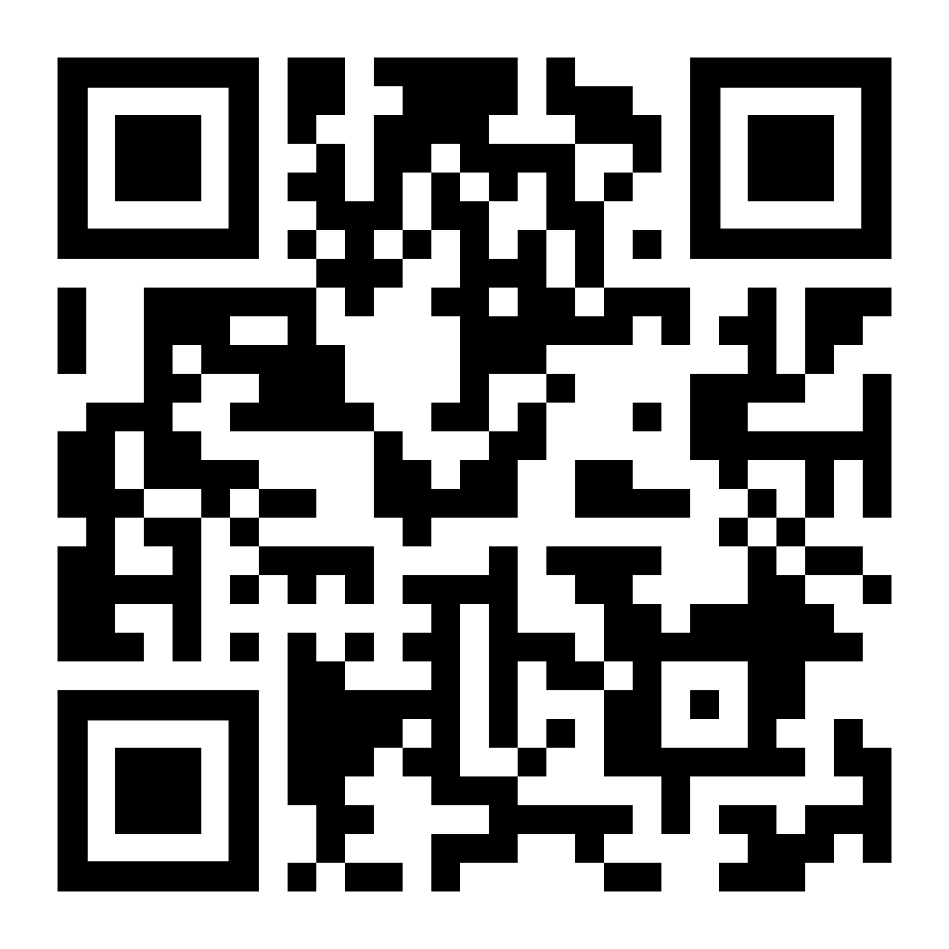
PG. 5
scout boss
Create an account at pecatonicariverpopcorn.com using Council Key 596TW﻿C

Slide 8
PG. 14
scout boss: place your orders
Order deadlines are:
Wednesday, July 23
Wednesday, August 20
Wednesday, September 17
Wednesday, October 29 The final order must be prepaid by October 29.

Slide 9
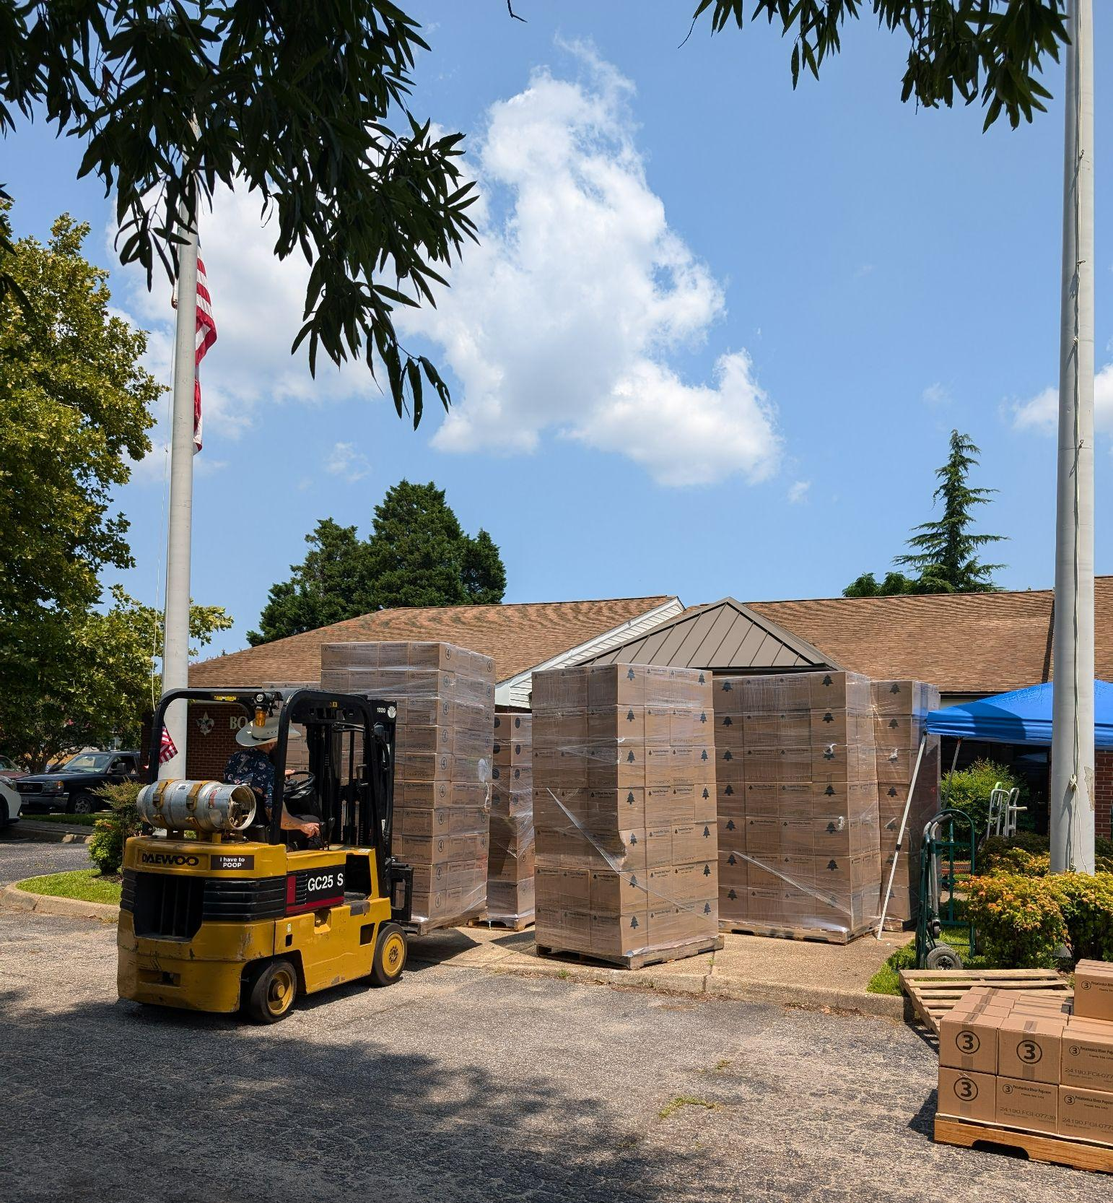
PG. 14
projected delivery dates
Thursday, August 7
Thursday, September 4
Thursday, October 2
Thursday, November 13

Slide 10

2025 PRODUCT MIX
PG. 26
Same flavors as 2024
The cost of goods has increased - primarily in the cost of chocolate
Second licensed military tin

Slide 11
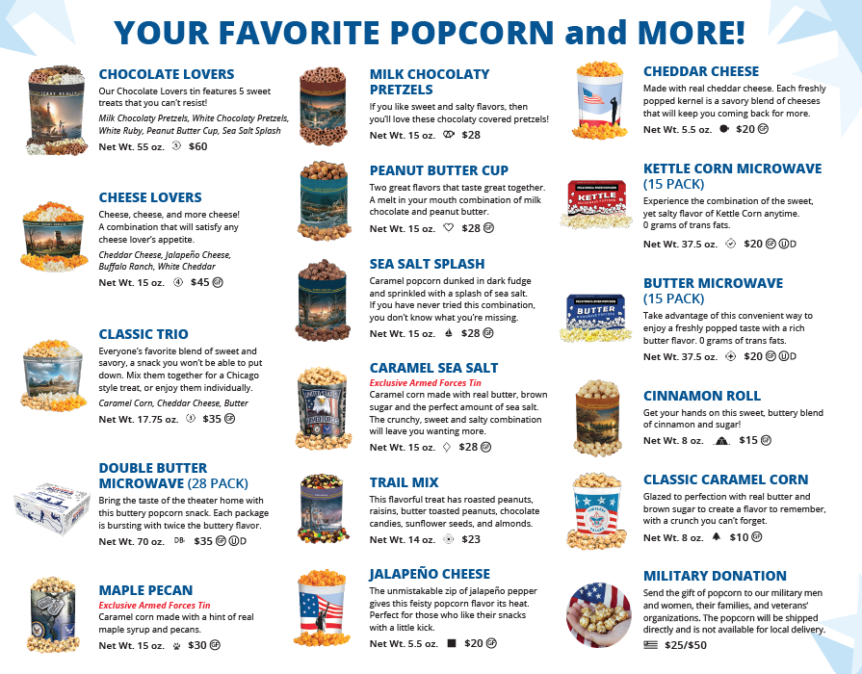
PG. 26
2025 PRODUCTS

Slide 12
online sales
PG. 27
August 1 - November 23
30% commission
Free shipping direct to customers
Different product than in-person sales
Chocolate products do not ship until the weather is cool
NEW for 2025: Shipping notifications with tracking link
NEW for 2025: Daily Online Summary Email Notification
pops@prpopcorn.com

Slide 13
rETURNABLE OR NOT RETURNABLE
(THAT IS THE QUESTION)
PG. 15
MELTED OR DAMAGED ITEMS: NON-RETURNABLE (The “Thunk Test”)
CHOCOLATE LOVERS: NON-RETURNABLE
CHEESE LOVERS & CLASSIC TRIO: RETURNABLE UNTIL SEPTEMBER 17
NEW FOR 2025: MAPLE PECAN IS RETURNABLE UNTIL OCTOBER 29
ALL OTHERS: RETURN DEADLINE IS OCTOBER 29 (NO EXCEPTIONS)

Slide 14
RETURNS AND FEES:
PGS. 15-17
A unit once again can return up to 10% of their TOTAL retail checkout. Yay!
Anything over 10% that is returned will incur a 20% restocking fee which will be added to the unit’s invoice. Boo!
If invoices are past due, the unit will not be able to receive prizes, order additional product, or pick-up additional product. Past due invoices are subject to compounding late fees.

Slide 15
transferring product:
PGS. 15-17
Units can enter and approve unit-to-unit product transfers through Scout Boss.
Do NOT attempt to transfer donations. Each unit should report their own donations using the “2025 Popcorn Prizes & Military Donations” form.

Slide 16

PAYMENT
DEADLINES
PG. 16-18
FIRST ORDER: Second order pick-up or September 6, whichever comes first
SECOND ORDER: Third order pick-up or October 4, whichever comes first
THIRD ORDER: October 29
FOURTH ORDER: October 29 (prepaid) - All popcorn balances paid in full.

Slide 17
PAYMENT methodS
PG. 18
CHECK
SCOUT SHOP ACCOUNT
CASH
eCHECK
CREDIT CARD (3% FEE)

Slide 18
all donations are military donations
PG. 20

Slide 19

PG. 20
SCOUTING AMERICA POLICY:
“At no time are units permitted to solicit contributions for unit programs.”
COLLECTING DONATIONS TO BENEFIT THE UNIT IS AGAINST SCOUTING AMERICA POLICY AND IS CAUSE TO REVOKE THE UNIT’S CHARTER.

Slide 20
PG. 20
IRS POLICY:
THE IRS MAINTAINS A DATABASE OF ORGANIZATIONS ELIGIBLE TO RECEIVE CHARITABLE CONTRIBUTIONS (PUB 78). THERE ARE STRICT REQUIREMENTS INCLUDING FILING AN ANNUAL FORM 990.
UNITS ARE NOT COVERED BY THE COUNCIL’S 501(C)(3) DETERMINATION.

Slide 21
PG. 20
STATE LAWS:
NORTH CAROLINA REQUIRES A CHARITABLE SOLICITATION LICENSE ISSUED BY THE STATE OF NORTH CAROLINA DEPARTMENT OF THE SECRETARY OF STATE.
VIRGINIA’S SOLICITATION OF CONTRIBUTIONS LAW REQUIRES REGISTRATION WITH THE COMMONWEALTH OF VIRGINIA DEPARTMENT OF AGRICULTURE AND CONSUMER SERVICES.
TIDEWATER COUNCIL’S LICENSES ARE NOT TRANSFERABLE TO UNITS.

Slide 22

PG. 37
THROUGH MILITARY DONATIONS, SCOUTS ARE NOT SOLICITING CONTRIBUTIONS.
THEY ARE SELLING PRODUCT AND EARNING A SALES COMMISSION.

Slide 23
PG. 20
LIKE ALL OTHER SALES, DONATION AMOUNTS COUNT TOWARD PRIZES.
EXAMPLE: IF A SCOUT SELLS $750 AND HAS $375 IN DONATIONS, THEY QUALIFY FOR THE $1,125 PRIZE*
*RETAIL SALES COMBINED WITH DONATIONS SUBMITTED MUST MATCH THE VALUE OF THE PRIZES REQUESTED.

Slide 24
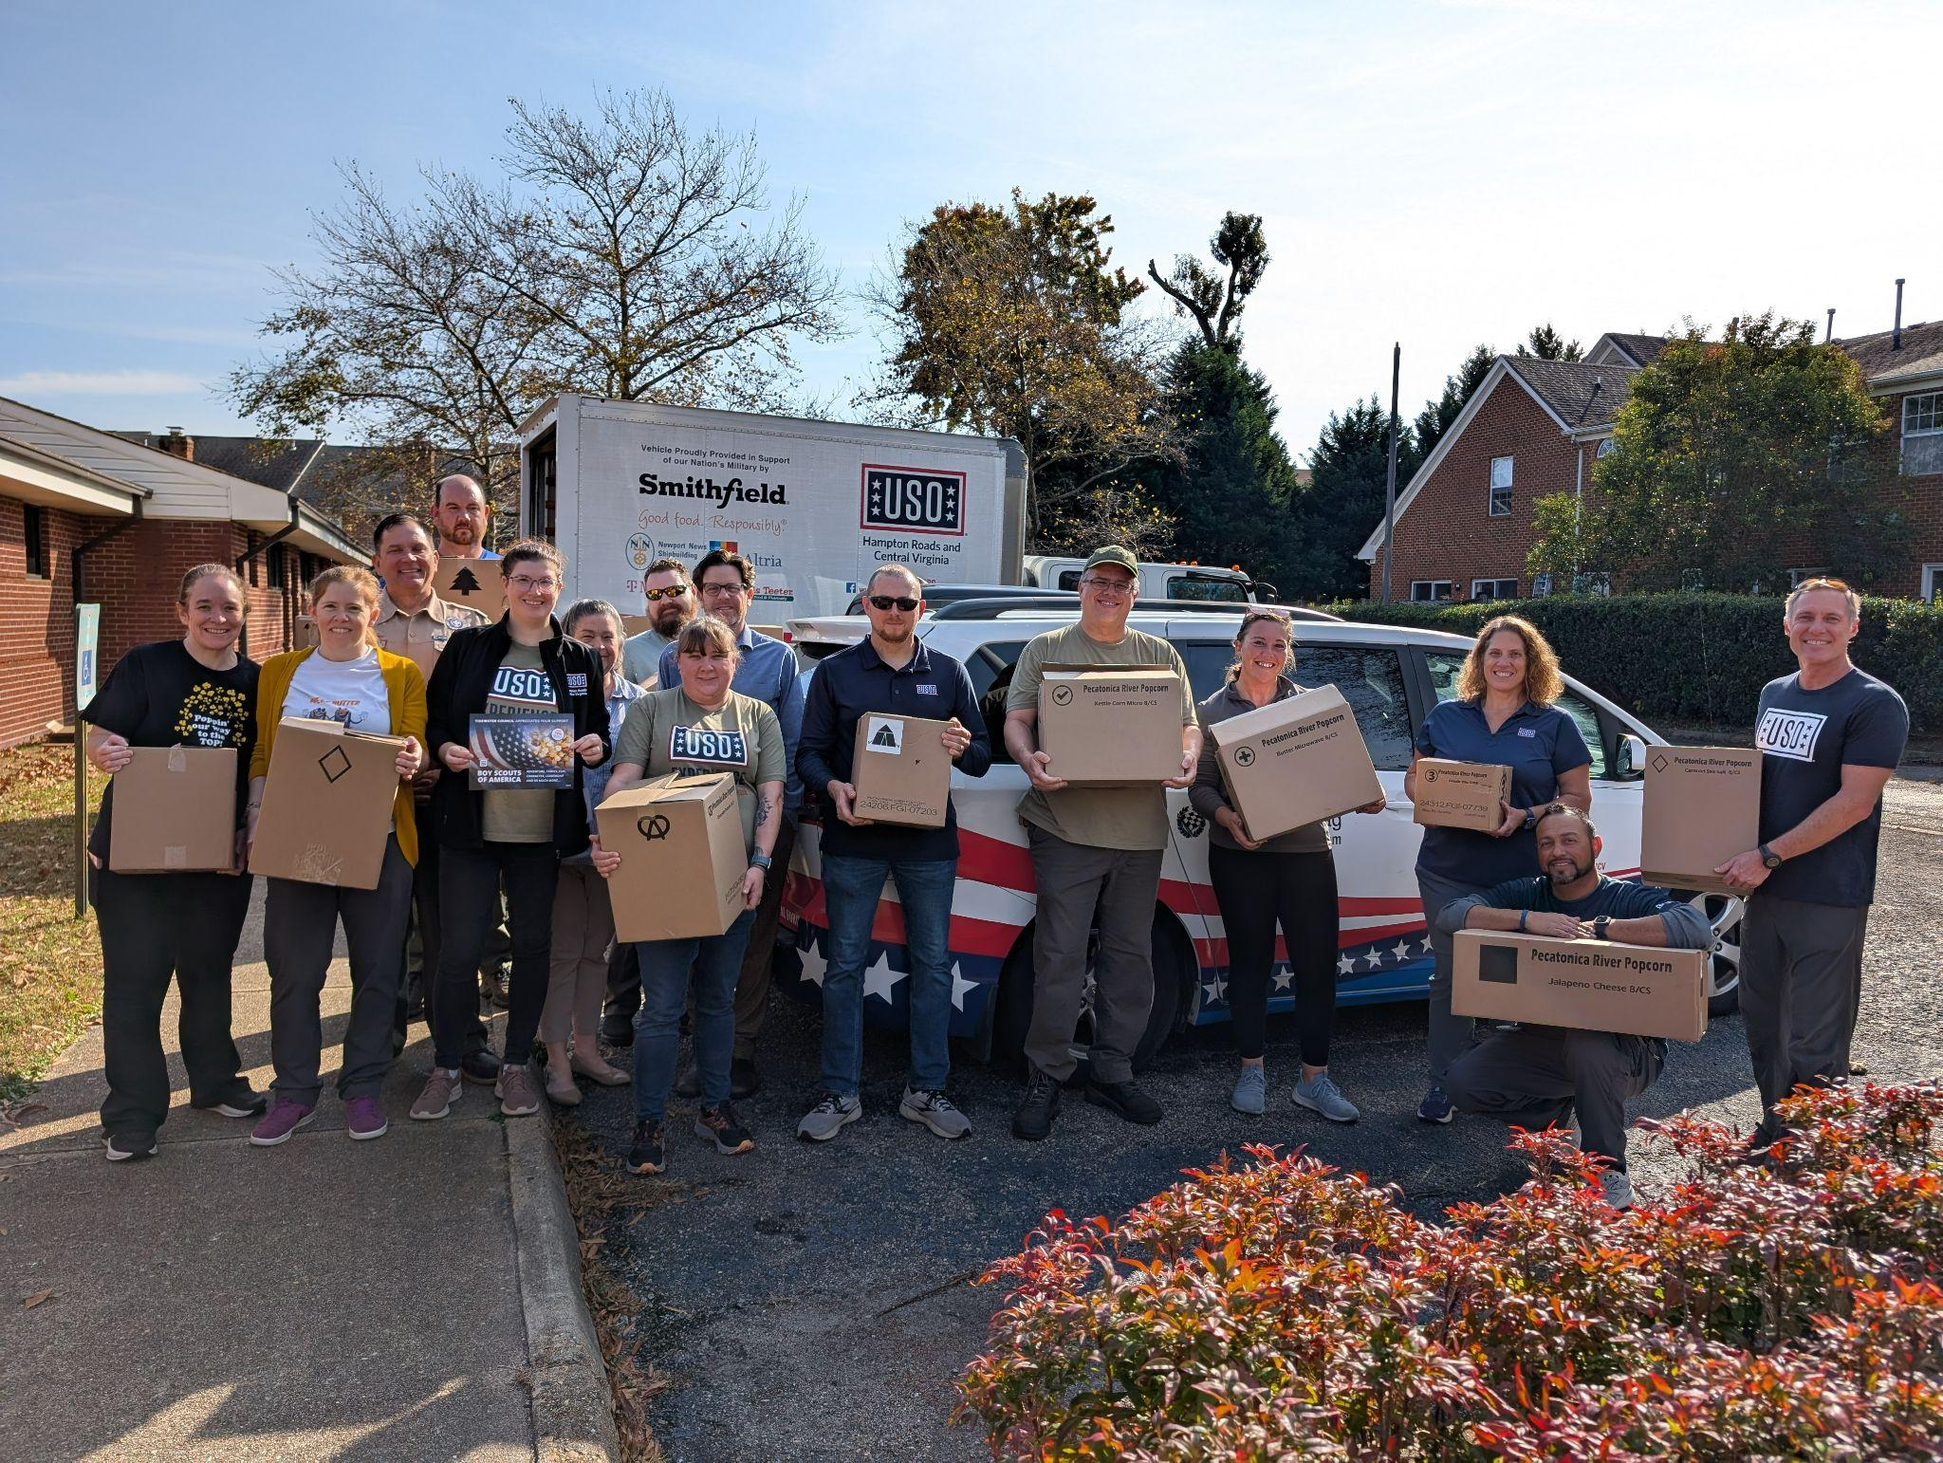
PG. 20
MILITARY DONATIONS HELP THE COUNCIL MANAGE INVENTORY.
THAT ALLOWS THE COUNCIL TO:
ACCEPT RETURNS
KEEP COMMISSIONS HIGH
TIDEWATER COUNCIL CANNOT RETURN POPCORN TO PECATONICA RIVER POPCORN

Slide 25
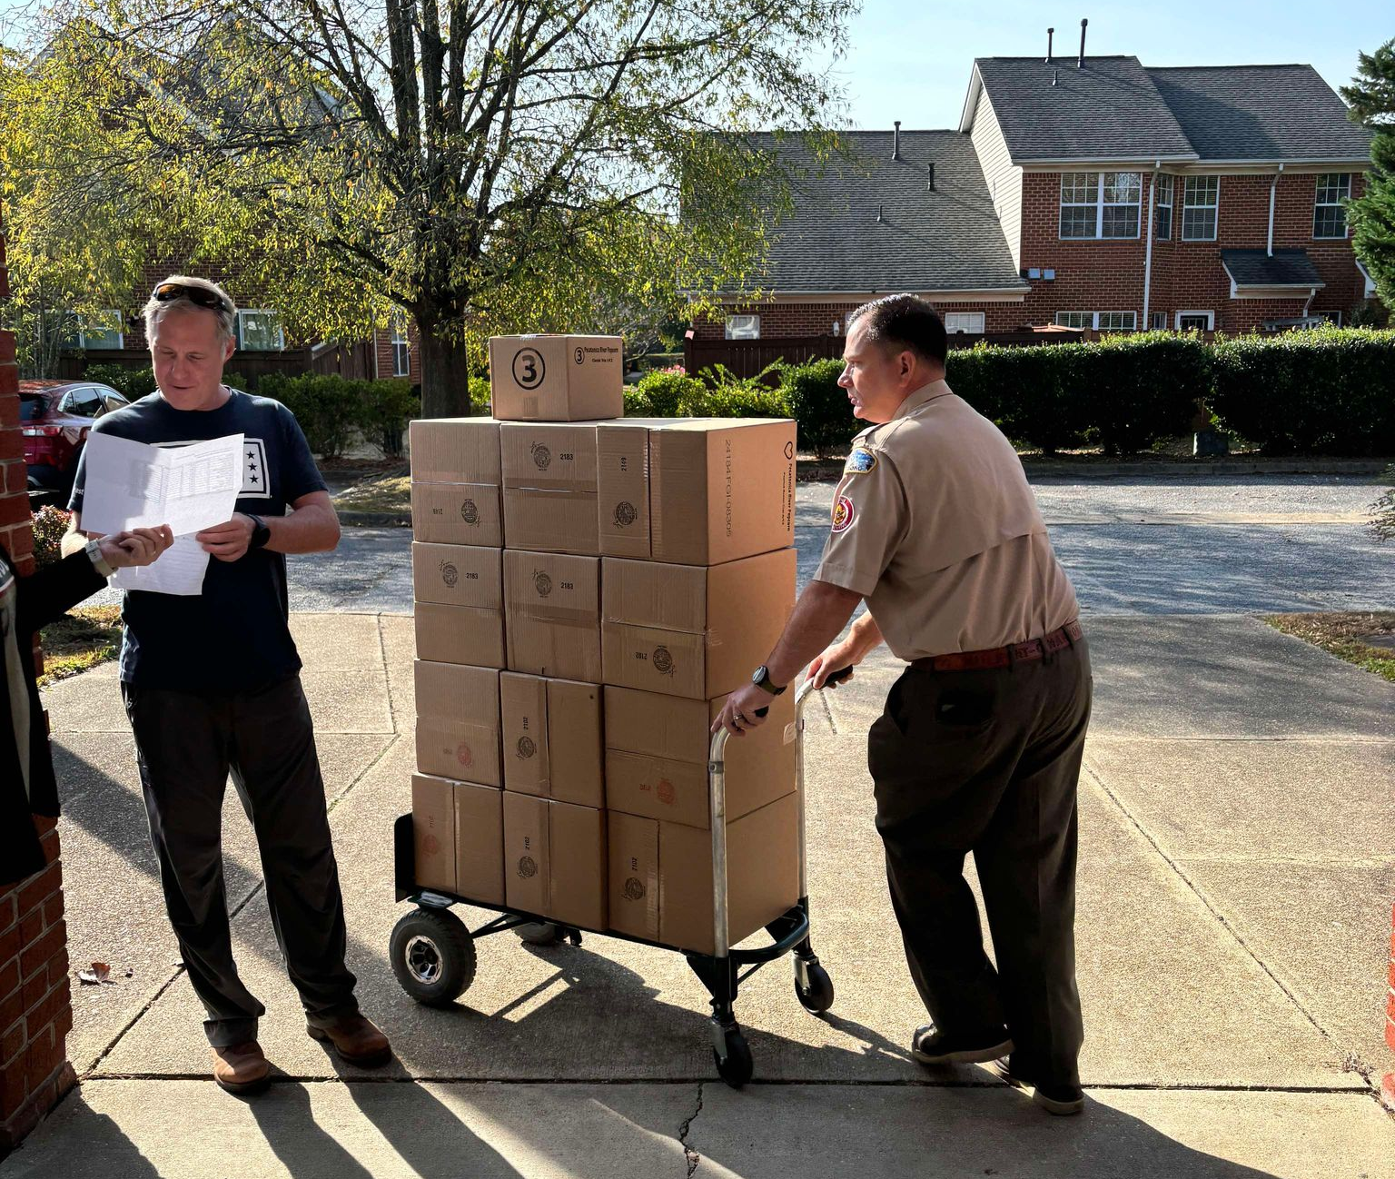
Military donations… why?
PG. 20
DONATIONS SUPPORT SERVICE MEN AND WOMEN, AND THEIR FAMILIES, IN OUR COMMUNITY.
A SCOUT IS TRUSTWORTHY.
AND TRUSTWORTHY LEADERS ARE THE ROLE MODELS FOR TRUSTWORTHY YOUTH.

Slide 26
PG. 21-25
what are the prizes?

Slide 27
top seller PRIZES
PG. 21
THE TOP 3 SELLERS IN COUNCIL WILL EACH RECEIVE A BONUS AMAZON GIFT CARD!
FIRST PLACE: $500 GIFT CARD
SECOND PLACE: $300 GIFT CARD
THIRD PLACE: $200 GIFT CARD

Slide 28
ARE ALL SCOUTS ELIGIBLE FOR the top seller prize?
PG. 21
THE SCOUT MUST BE A REGISTERED MEMBER AND THE UNIT POPCORN INVOICE MUST BE PAID IN FULL. ANY UNITS NOT PAID IN FULL WILL DISQUALIFY THEIR TOP-SELLING SCOUT.
2. GOOD NEWS: SCOUTS CAN SELL THEIR EXCESS INVENTORY OR CONTINUE TO SELL ONLINE THROUGH NOV. 23....THIS GOES TOWARD PRIZES.
3. TOP 3 SELLERS WILL BE NOTIFIED ON OR BEFORE DEC. 19

Slide 29
BUT WAIT!
THERE’S MORE!

Slide 30

council-level prizes
PG. 22
$125: PATCH
$525: CINEMA CAFE MOVIE TICKET
$1,125: $35 AMAZON CARD
$2,125: $50 AMAZON CARD

Slide 31
BUT WAIT!
THERE’S even MORE!

Slide 32
MILITARY DONATION RECOGNITION:
PG. 23
REPORTING DONATIONS THROUGHOUT THE SALE HELPS TIDEWATER COUNCIL MANAGE INVENTORY.
THAT ALLOWS THE COUNCIL TO ORDER EXTRA INVENTORY FOR INTERIM CHECKOUTS.

Slide 33
MILITARY DONATION RECOGNITION:
PG. 23
Scouts will earn military-themed pins for their popcorn sales patch as donations are reported throughout the sale!
August 1 - August 20 (submarine)
August 21 - September 17 (Coast Guard cutter)
September 18 - October 29 (helicopter)
October 30 - November 30 (tank)
Scouts may earn up to four pins throughout the 2025 Popcorn Sale.

Slide 34
MILITARY DONATION RECOGNITION:
PG. 23
If a Scout’s donations during a reporting period total more than $25, the extra amount will be “banked” toward future pins. Unit Popcorn Kernels should report current and accurate donation totals by each deadline, and council popcorn committee members will ensure that recognitions are awarded.
Donations may NOT be applied to past recognition periods to earn previous awards after submission deadlines.

Slide 35
BUT WAIT!
THERE’S even MORE!

Slide 36
PG. 24
WINNERS CIRCLE:
SELL $3,125: $200 AMAZON, BEST BUY, OR AMC GIFT CARD, OR SELECT PRIZES
EACH ADDITIONAL $3,125 GETS ANOTHER $200 GIFT CARD OR PRIZE (AND SO ON AND SO ON…)

Slide 37

SO….. If a scout’S sales/donations equals $9,375 they will get all FOUR COUNCIL-LEVEL prizes and (3) $200 gift cards or winner’s circle prizes!

Slide 38
NEW FOR 2025: STREAMLINING PRIZE REQUESTS
PG. 21-25
To streamline the data entry process for Unit Popcorn Kernels, council-level prize requests will coincide with military donation recognition requests ON ONE FORM!
Submission deadlines are August 20, September 17, October 29, and November 30.
Google Sheet and Excel options will be available.

Slide 39
final Prize submission
DEADLINE
NOVEMBER 30 (NO EXCEPTIONS)

Slide 40
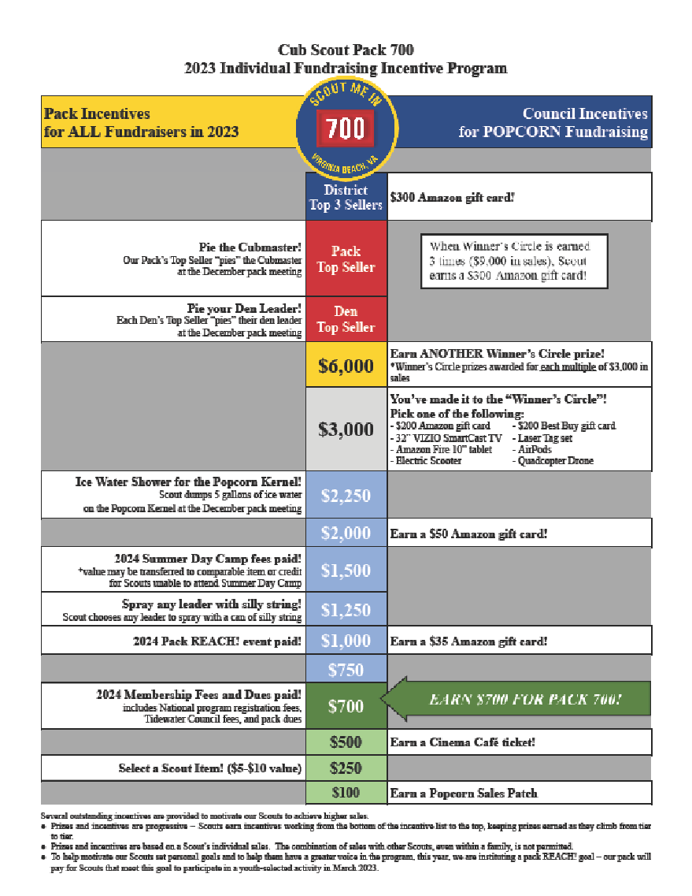
2023 uNIT INCENTIVE SAMPLE
ADD UNIT INCENTIVES TO COUNCIL-PROVIDED INCENTIVES TO FURTHER MOTIVATE SCOUTS

Slide 41
LOWE’S
PG. 28
Districts will manage Show & Sells at Lowe’s locations and Lynnhaven Superior Pawn (Lishelle Place)
2025 update: No range pass vouchers at Superior
If you need to cancel a reservation, delete the signup from SignUpGenius AND post in the Facebook group

Slide 42
LOWE’S
PG. 28
Signups for August dates:
Virginia locations:
Those who attend Popcorn Training (that’s you!) get early access on Wednesday, July 9
All others may sign up starting on Friday, July 11
Extra slots will be released on Monday, July 14
North Carolina locations: Signup release will be delayed
Signups for September & October dates:
Signups will open Thursday, July 17
Extra slots will be released on Monday, July 21

Slide 43
food lion
PG. 28
Two Food Lion dates available:
Saturday, October 11 from 10 AM - 6 PM
Saturday, October 18 from 10 AM - 6 PM
Signups:
Signups begin on Thursday, July 24
Extra slots will be released on Monday, July 28
Signups close on Wednesday, September 24
Follow Food Lion’s rules and visit the location in advance

Slide 44

COMMUNICATE, COMMUNICATE, COMMUNICATE
PG. 32
Your District Kernel is here to help your unit succeed. Reach out to them to help strategize product, sales, and set goals.
Our goal is for your unit to be successful….

Slide 45
introducing your 2025 popcorn crew:
PG. 32
Albemarle-Nann Jones: nannjones@hotmail.com
Bayside-Krista Dunn: Krista.dunn1621@gmail.com
Scott Gilmore: esgilmore70@gmail.com
Princess Anne-Tony Montemurno: kerneltbaloney@gmail.com
Matt Conway: 19mconway84@gmail.com
Three Rivers-Rudy Nimmo: vtccgolf@gmail.com
Clark Walters: Crazyscout94@gmail.com
Tammy Walters: crazybear127@yahoo.com
Council Kernel-Erin Alger: erin@realresultsva.com

Slide 46

hERE’S TO A GREAT POPCORN SEASON!
Any questions?

