Slide 1
2024 Membership Renewal and Unit Renewal

Slide 2
Agenda
Introduction
Membership Renewal
Unit Renewal
Resources
Q&A

Slide 5
Individual Membership Renewal
60 Day* | Notice Expiration Date | 60 Day* Lapse
6/1/2024 | 7/31/2024 | 9/30/2024
7/1/2024 | 8/31/2024 | 10/31/2024
8/1/2024 | 9/30/2024 | 11/30/2024
9/1/2024 | 10/31/2024 | 12/31/2024
10/1/2024 | 11/30/2024 | 1/31/2025
11/1/2024 | 12/31/2024 | 2/28/2025
12/1/2024 | 1/31/2025 | 3/31/2025
1/1/2025 | 2/28/2025 | 4/30/2025
2/1/2025 | 3/31/2025 | 5/31/2025
3/1/2025 | 4/30/2025 | 6/30/2025
4/1/2025 | 5/31/2025 | 7/31/2025
5/1/2025 | 6/30/2025 | 8/31/2025
Starting 8/01/2023, all memberships are individual twelve-month terms.
60 – Members will get renewal notices by email starting sixty days (i.e., two months) prior to expiration date.
30/15 – Reminder email messages will occur at thirty days (i.e., one month) and fifteen days prior to expiration date as well.
60 – There is a sixty-day (i.e., two months) lapse period from the date of expiration before the member will be dropped.
YES, it is possible for units to renew its own members.

Slide 6
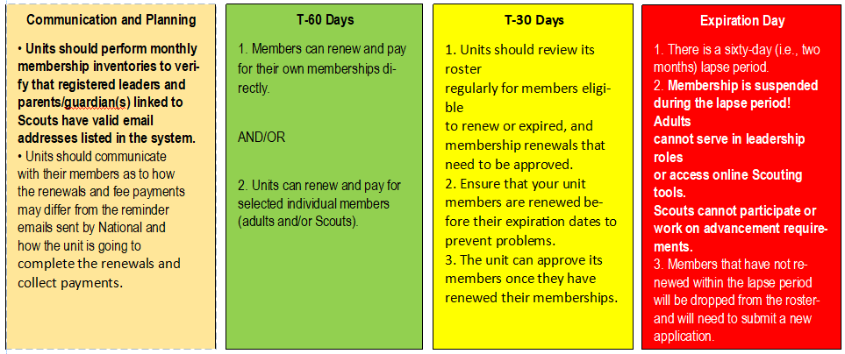
Individual Membership Renewal-Unit Timeline
Starting in August, Scouting membership registration for youth and adults is now annual, rather than pro-rated to December. Parents and leaders can either renew and pay their registration online or the unit can renew it for them. Units need to look at their membership on a monthly basis to make sure members renew on time and approve renewals.

Slide 7
Unit Monthly Membership Renewal Checklist
Make sure registered leaders and parents/guardians have valid email addresses listed in the system
Communicate with registered leaders whose registration and YPT expire within the 60- and 30-day window
Notify families know if they and/or their Scout are set to expire within 60 and/or 30 days
Approve leaders and Scouts who have renewed or will renew online
Submit payment and roster to the council, if unit pays for their members registration fees.
If members registration has expired, inform them that adults cannot serve as leaders, youth cannot participate, work on advancement and both leader and youth could lose use of online Scouting tools.

Slide 8
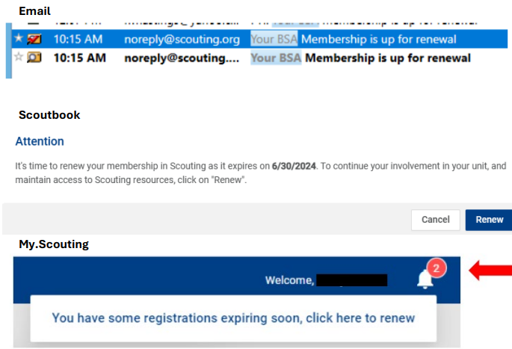
Membership Renewal
It is CRITICAL that email addresses are correct in the system for:
Registered adult members.
Parent/guardian(s) linked to youth members.
Email messages will be sent from the My.Scouting.org system directly to the associated members from noreply@scouting.org.
Members may get multiple messages depending on their various positions.
The member will receive a payment receipt through email after the membership renewal process is completed

Slide 9
Two Ways to Pay
MEMBERS PAY DIRECTLY
Members renew and pay for their own memberships and/or the memberships of Scout youth in their families without involving the unit.
Payment is made by the individual members/families either online or offline at the Tidewater Council Scout Service Center.
UNIT PAYS FOR MEMBERS
Units can select members (individual adults and/or Scouts) to renew and pay for when their memberships come due.
Unit funds are used to make payment online or offline at the Tidewater Council Scout Service Center.

Slide 10
2024 Membership Renewal Prices

Slide 11
Unit Renewal
Getting Ready:
60 – The Unit Renewal option becomes available to units on 10/01/2024, sixty days (i.e., two months) prior to the unit charter expiration date of 12/31/2024.
Key 3 + COR Delegate will get renewal notices by email.
30 – Units should complete their renewals within the first thirty days after becoming eligible and must be completed prior to the unit charter expiration date (10/31/2024).
There is a sixty-day (i.e., two months) lapse period from the unit expiration date and then the unit will be dropped.
It is critical that units begin preparing for Unit Renewal NOW:
Unit must have the required number of leadership positions filled:
Cub Scouts = 6 Scouts BSA = 5
Leaders must have current paid membership.
Leaders must have successfully completed background check and Youth Protection Training (YPT).
Leaders must have valid email addresses listed in the system.
Unit must have at least five registered Scouts of appropriate age/grade for the program.
Units with female Scouts must have at least one registered adult female leader

Slide 12
Unit Renewal Timeline
Communication and Planning
Determine a Unit Renewal Champion (should be one of the Key 3 or COR Delegate).
Verify login for My.Scouting.org.
Verify that the required positions are filled (Cubs=6; Others=5).
Verify that listed leaders have completed background check (lead time is six weeks for new registrations) and have completed or renewed Youth Protection Training (YPT) to be valid through 11/30/2024.
Leaders must have valid email addresses listed.
Unit must have at least five registered Scouts.
Print and review the Unit Charter Agreement.
T-60 Days
1. Unit Renewal Champion logs into My.Scouting.org and submits online Unit Renewal request. Print a copy for the unit’s records.
2. Unit submits payment ($100) for the renewal.
3. Unit prints the Unit Charter Agreement, has it signed by the Unit Leader, COR, and Unit Commissioner, and then submits it to the Council.
T-30 Days
Do not delay in getting the Unit Renewal submitted as there could be delays in processing.
Submit the online renewal request regardless of the Unit Charter Agreement status
Council Registrar verifies Unit Renewal request, payment, and signed Unit Charter Agreement; any missing items or other issues must be resolved.
Council Registrar approves the Unit Renewal request
Expiration Day
There is a 60 day (i.e., 2 month) lapse period; the unit is considered suspended during this time.
Units with an incomplete Unit Renewal will drop from the Council roster on 1/01/2025.
Members of dropped units become “Members without a unit” and will need to be assigned to a new unit.
Individual membership is valid for twelve months from the month in which registration started

Slide 13
REQUIRED for Unit Renewal:
Required for Unit Renewal:
Minimum number of positions filled (Cubs=6; Others=5).
Leaders must be 18+ years old and have successfully completed the background and YPT.
Unit has five registered Scouts of appropriate age/grade.
Unit Renewal request (online) and fee payment have been submitted.
Keep it simple and focus on what is needed for completing the Unit Renewal quickly.
The Unit Charter Agreement also needs to be printed, signed, and submitted, but this does not prevent the Unit Renewal process from being completed online.
NOT required for Unit Renewal:
Membership Roster
Journey to Excellence (JTE)
Friends of Scouting (FOS) presentation scheduled JTE and Detailed Assessments are encouraged as part of Unit Service, but are no longer associated with the Unit Renewal process.

Slide 14
Need Help?
Review the Membership Renewal and Unit Renewal pages at https://tidewaterbsa.com/renewals, including the FAQ and Resources listed at the bottom of the pages. These are all updated regularly to contain the latest information.
Attend Roundtable. Commissioners and other District volunteers regularly attend District Roundtables and will be able to answer your questions.
Contact your Unit Commissioner. Find their name and contact information at https://my.scouting.org > Organization Manager > Unit Dashboard > Unit Summary > Commissioners > click on the name of the Commissioner listed. If you do not have a Unit Commissioner, then contact your District Commissioner
Contact your District Executive, their contact information can be found at https://tidewaterbsa.com/staff-directory/
If the above options are unable to answer your questions or provide the necessary assistance, then you will be directed to somebody who can!

