Slide 1
Welcome to the 4th Annual POPCORN 101
Popcorn Season Fundamentals for Unit Kernels, Committee Chairs, Treasurers, and anyone interested in the wonderful world of all things popcorn!

Slide 2
Objectives
Why do we sell?
Understanding the budget and its role in popcorn sales
Before the corn
Popcorn arrival date, then what?
Conducting personal sales
How to set up and conduct a Show and Sell
Information for families. Conducting a popcorn kickoff/taste testing event
How much popcorn should I order?
Accepting credit cards and electronic payments
Tools available (Apps, FB page)
Unit incentives
Importance of communication within Popcorn Chain of Command. (Unit Kernel, District Kernel, Council Kernel, Popcorn Staff Advisor)

Slide 3
Why we do it Other Benefits of Selling
Raise money for unit activities and needs
Highest commission in nation
Scouts earn prizes
Scouts build camaraderie
Scouts learn communication skills, salesmanship, and earning their own way
Build a foundation for Eagle project fundraising
Can earn advancement requirements

Slide 4
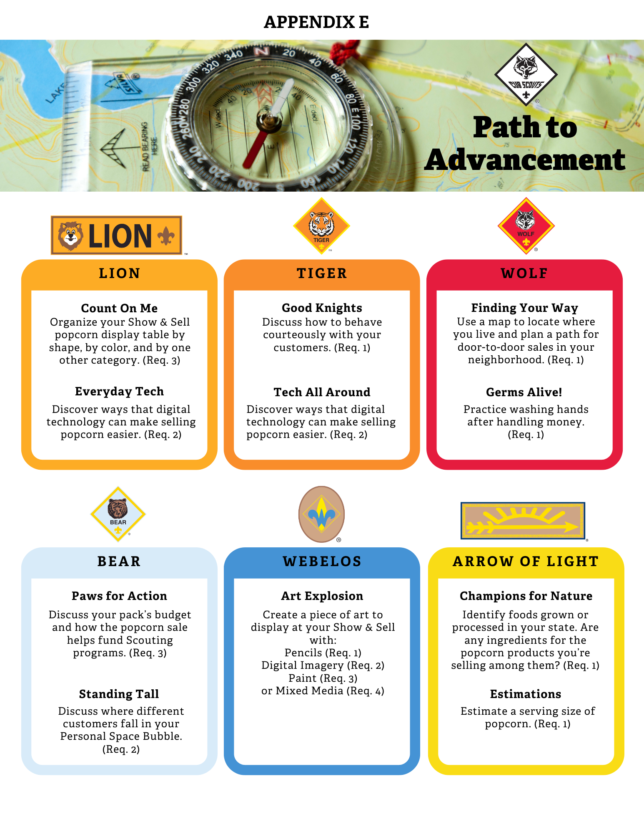
Cub Scout Advancement

Slide 5
Scouts BSA Merit Badges

Slide 6
Council Benefits

Slide 7
New tent platforms at Site 2

Slide 9
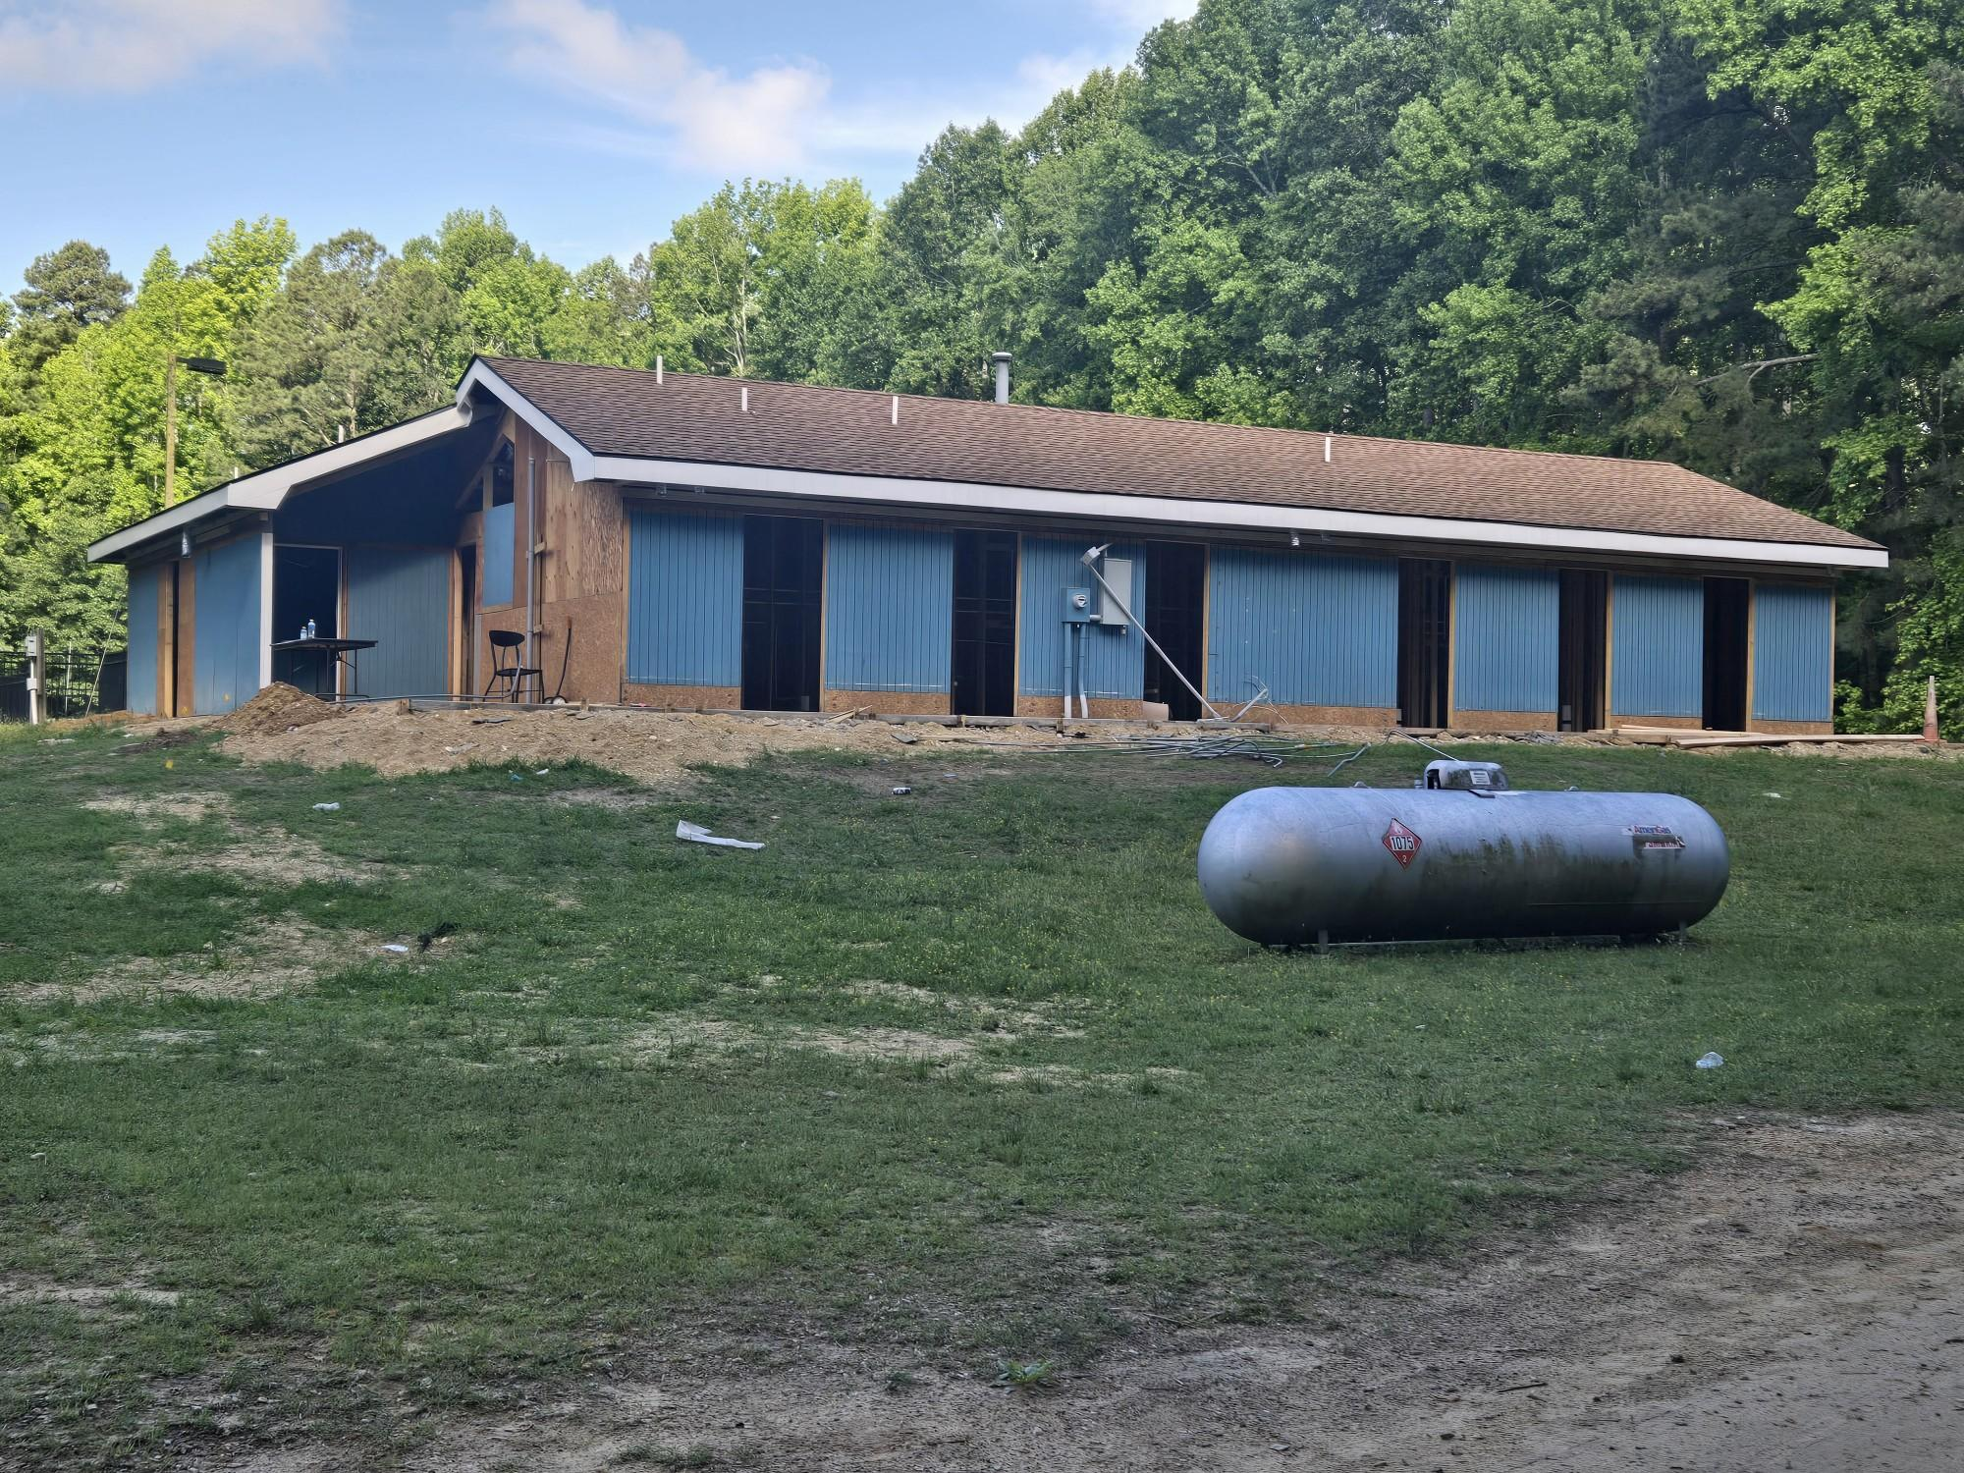

Slide 10
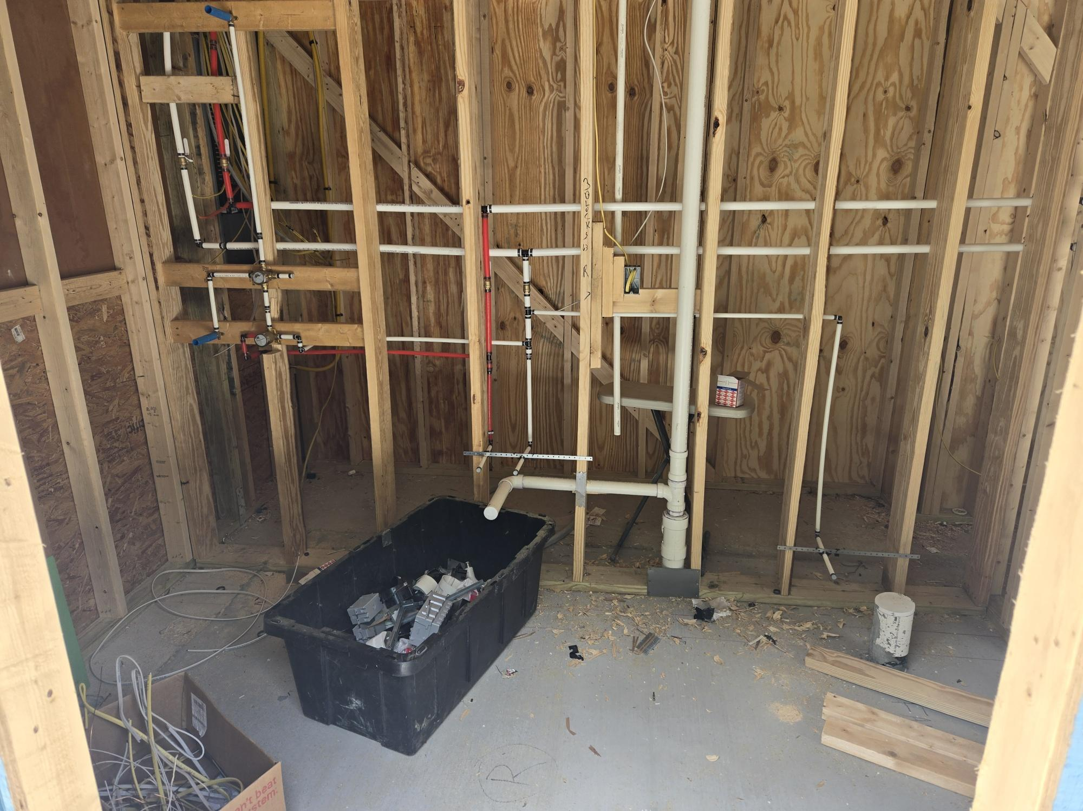

Slide 11
The Budget
Importance of the budget
Covers unit activities and costs for the year
Break it down to a sales goal for each Scout
Parents want to know where their money goes
Transparency of money flow
Many ways to format a budget
Pack Tiers
-Identifies benefits at certain sales levels.
Popcorn Kernel-Treasurer-Committee Chair- Cub/Scoutmaster relationship

Slide 12
Before the Corn
Council leadership and Council Kernel meet with vendor to establish contract. (Feb/Mar)
Unit kernels start making their plan. (≈March)
101 Training (May)
Units establish their budget and sales goal. (Jun/Jul)
June:
Seasonal Training #1
Aug Lowe’s dates released
July:
Remaining Lowe’s S/S dates released
Seasonal Training #2
Units hold kickoff party -Kernel discusses plan and, -Hands out supplies:
Sign
Money envelopes
Order form
Large unit money envelope
Tasting kit
Units submit their first order.

Slide 13
Product Arrival
4 orders submitted ≈2 weeks prior to arrival date (key to our success?)
First Thursday in August Semi truck delivers 1st product order -Helpers pick up product that day (vice making appt).
Subsequent orders arrive: -Early September -Early October -Mid November
Paid for in advance when ordered.
All payments due.

Slide 14
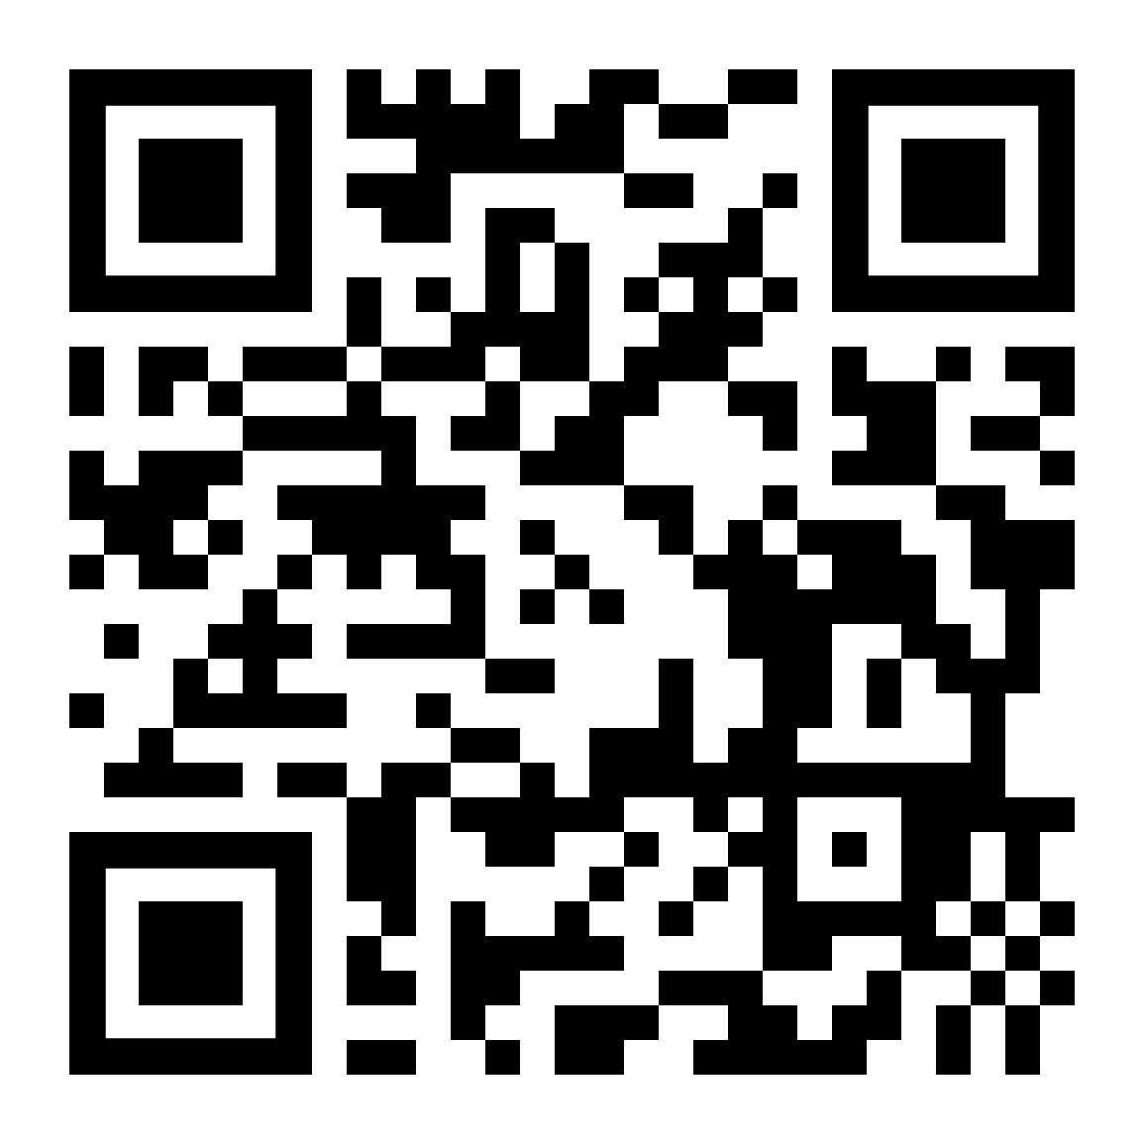
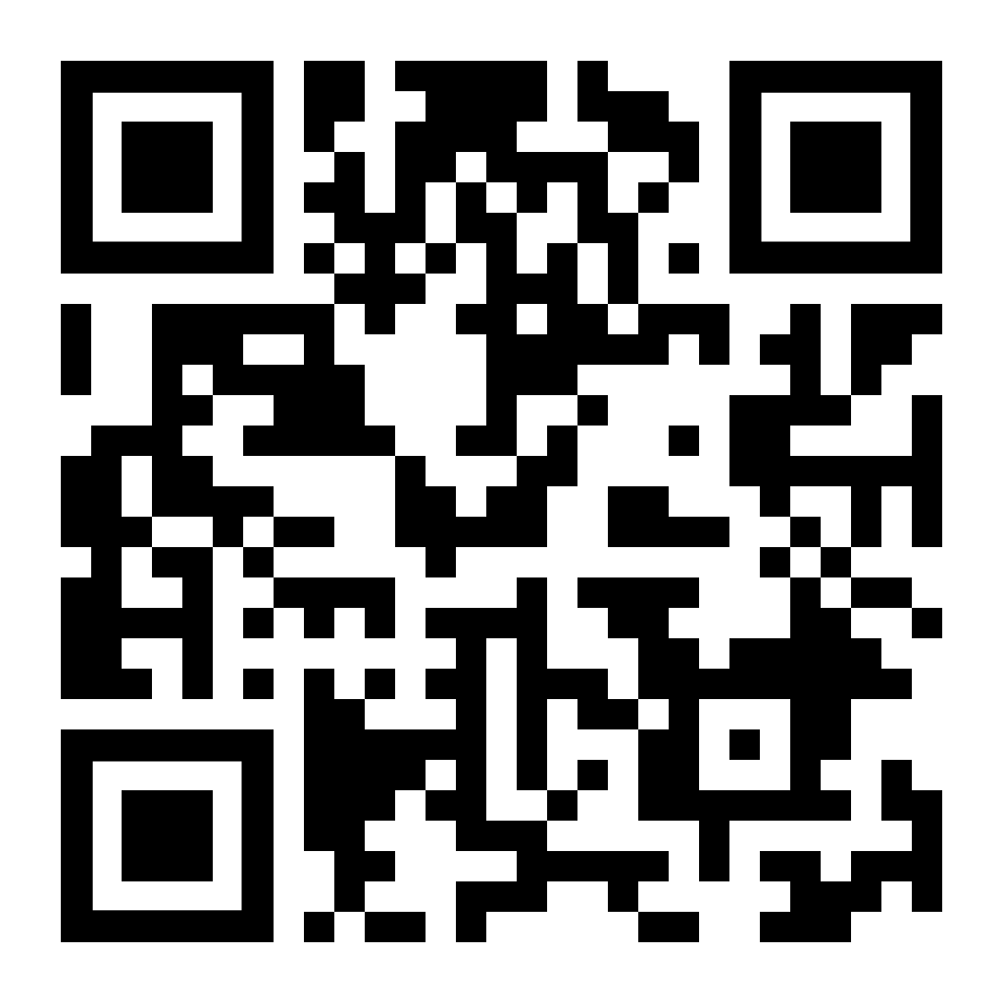
Personal Sales
Door to door
Best to have product in hand.
Keep the chocolate products cool.
Take order form to work
Friends, neighbors, local family members
Online (30% Commission) http://www.prpopcornstore.com/
Kernel establishes account for each Scout pecatonicariverpopcorn.com
Email from ‘Pops’ (?)
Include these sales for Scout’s prize total
Free shipping

Slide 15
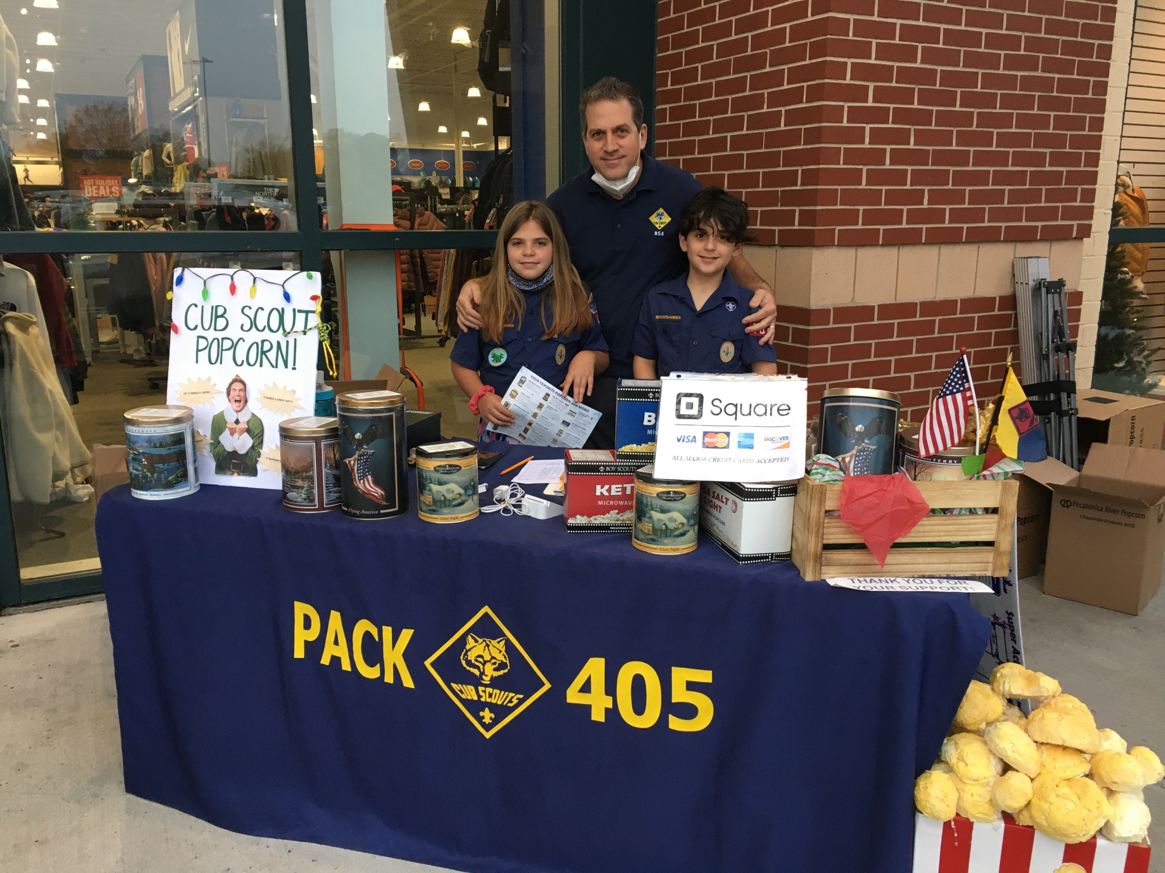
Show & Sells
Selling in front of a business, at an event in public, etc.
Talk to store/event manager to set up.
Have paper trail of booking confirmation and resolve conflicts professionally.
Understand and follow THEIR rules
Ask parents for places where they might have connections.
Cubs- work in pairs with 2 parents
Certain companies restricted (Home Depot, Wawa, etc.)
Break out the bling (Unit flag, tablecloth, home made décor, etc.)
Keep meltables cool
Bring membership flyers/joining information
Keep notebook with several order forms to show product, a tracking sheet and money envelope for each shift, money box with petty cash ($100), and credit card device/app.
Track inventory throughout the sale. Scout’s sales can get lost if cash/credit sale is not documented correctly.

Slide 16
Popcorn Kickoff Party
Plan for this with your unit before submitting your first order, preferably. Find out if parents want extra product for door-to-door sales, taking order form to work, etc.
Have your selling strategy in place prior to meeting
*STARTING EARLY IS THE KEY TO SUCCESS*
Form a Popcorn Crew based on unit size (Kernel, Treasurer, S&S crew, Inventory crew)
Do taste testing
Make it fun for kids and informative for parents
Use the popcorn guide as your reference
Discuss what Scouts should say to customer (Cubs)
Discuss use of show and sell tracker and credit card app
Will Scouts get credit for their shift, or all Scouts split the day??

Slide 17
Important information from Unit Kernel to parents
Track items checked out to families (receipt book, text, etc.)
30 days to sell it or return it. MAKE SURE THEY UNDERSTAND
“Returns” are a financial loss to council if not sold or donated. They do NOT get returned to the popcorn company.
Maintain neat records. Will submit copy of order forms for Winners Circle (>/= $3000) prizes.
Parents need to know deadline dates for the 4 orders and submit their order to the Kernel prior to those dates
Contact parents for their personal orders before each order is placed to ensure an adequate supply is on hand for Show and Sells
Do not tap into Show and Sell stock to satisfy take-orders unless necessary. Utilize unit-to-unit transfers.

Slide 18
“How much should I get?”
Look at what was sold last year. Are the same Scouts selling this year?
Base it on YOUR plan:
What Show & Sells are scheduled?
Which parents want to walk the neighborhood with their Scout?
Do parents take order forms to work?
Have funding in unit’s bank acct to cover 60% of total retail for 1st order
Plenty of opportunity to sell off first order. (4 orders total)

Slide 19
“How much should I REALLY get?”
$10 Classic Caramel always the biggest seller. 2022 Council sales ≈ 25% (13,019/52,441 units sold). Troop of 13 scouts sold 177 of 2116 cans; >8%)
Caramel with Sea Salt another favorite (Council sales: 9% or 4815 cans)
Pick up all flavors and at least 1 of each of the top 3 non-returnables. You’ll sell it or transfer to another unit.
My unit sales in 2020/2021/2022/2023 respectively: Choc Lovers (6/12/7/16), Cheese Lovers (12/20/14/13), Trio (10/15/8/17).
Cheese and Trio usually returnable for limited time
When in doubt, talk to your District Kernel for guidance.
**NOTE**Do not let meltables (Chocolates, Pretzels, Sea Salt Splash, etc.) melt. Store in house, not garage. Products are subject to thunk test upon return.

Slide 20
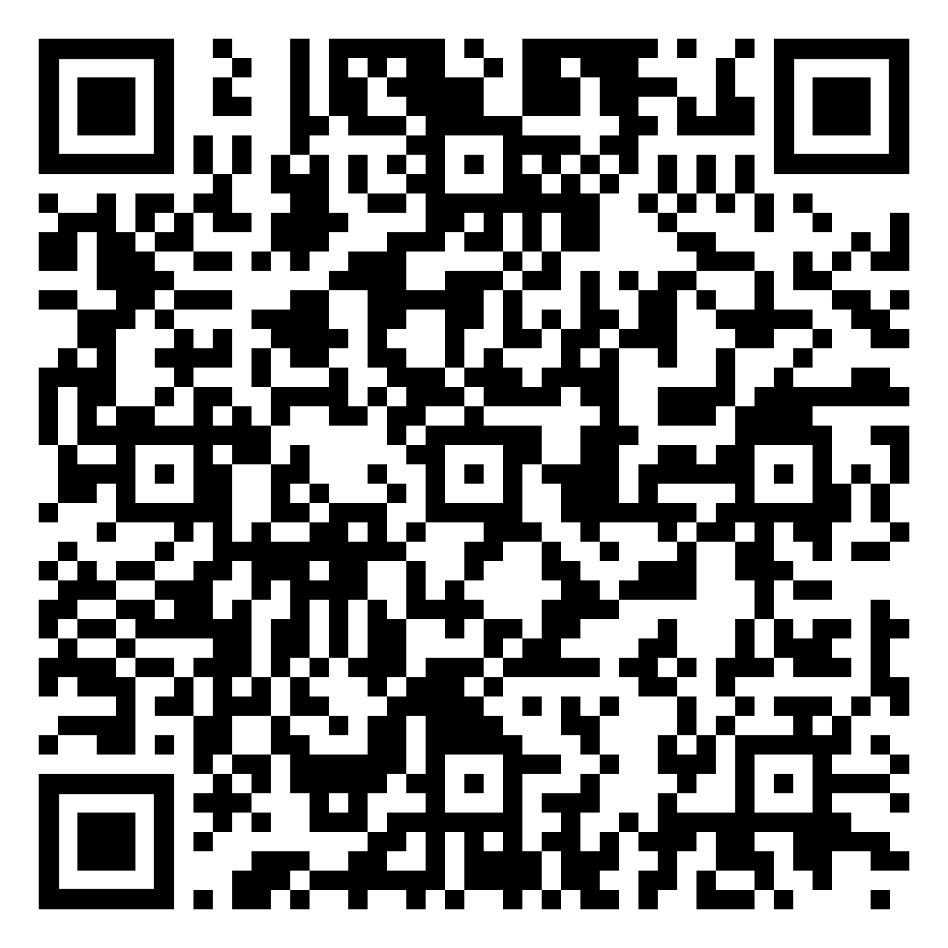
Using Credit Card Apps
Utilize unit EIN and name on bank account (not your personal info) when establishing your account (1099-K)
For more info, https://www.scouting.org/wp-content/uploads/2023/05/Fiscal_Policies_and_Procedures_for_BSA_Units_May_2023.pdf
BSA does not endorse any credit processing vendor.
Different phone connections or Bluetooth
Card info can be inputted manually (will cost more)
App company takes their cut
Review transactions on your app at the end of the day to verify your S/S sales.
More info on Pecatonica website.

Slide 21
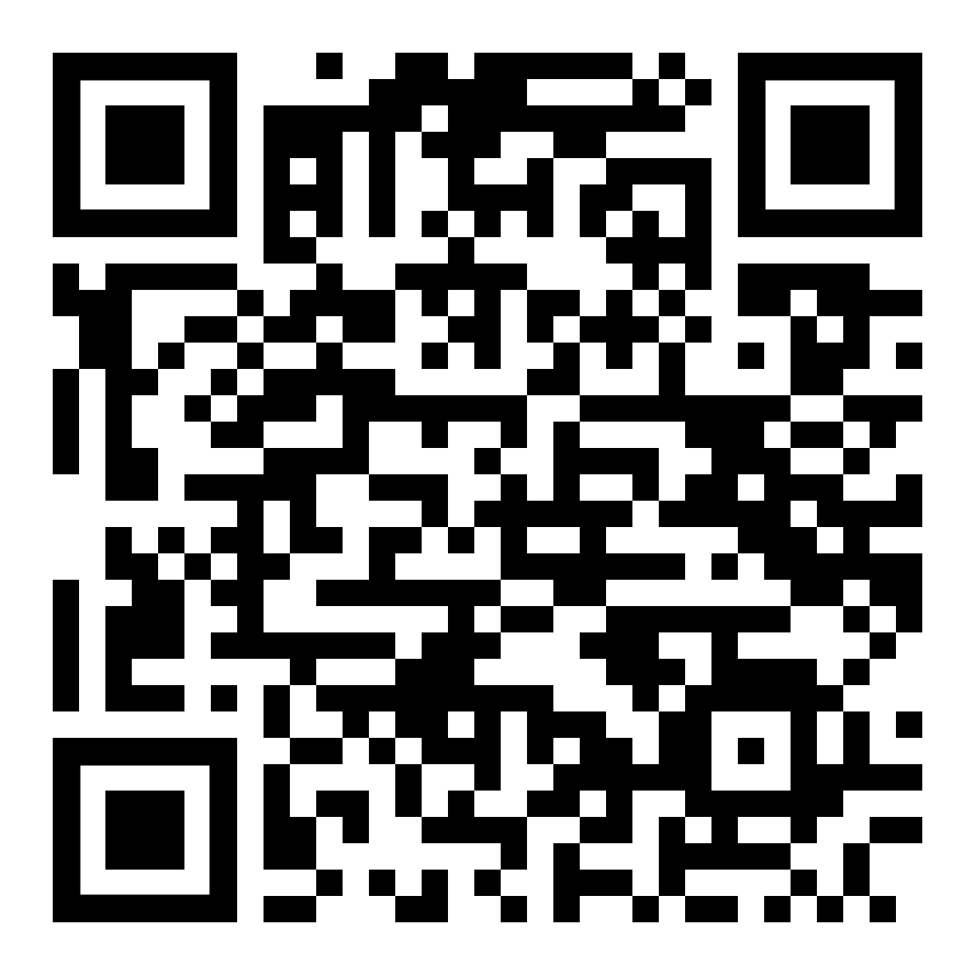
Communications and Tools
Sign up on Tidewater Council Popcorn Kernel FB group.
Lowe’s release dates, product swaps, real time updates, etc.
Keep district and council informed of plans for excess inventory
Don’t order more if you have a large enough surplus for planned sales. Exchange with other units.
Kernel Tracker
Build or acquire a sales/inventory tracker
Notify parents of their Scout’s credit after S&S. They can add line item to their Scout’s order form to document their Scout’s credit for each S&S event.
Documentation of each Scout’s sales will be required for Winner’s Circle Prizes
Pay on time. Get donations in when picking up next order.
Sign up on Tidewater Council Popcorn Kernel FB group.

Slide 22
Unit Incentives
Use tier method to fund extras like registration, summer camp, etc.
Budget for unit prizes for certain sales goals in between council prize levels (e.g., $250, $750, $1,500)
Grab bag
Pizza party for unit goal
Pies in the face (paper plates vs good China)
Unit T-shirts/hoodies

Slide 24
Show and Sell Tracker
Shift number | Date and time |  |  |  | Scout #1 Name | Scout #2 Name | Scout #3 Name
Product | Price | Previous shift's ending inventory | Your Shift's Starting inventory | Any items added mid-shift | CASH SALES | CREDIT SALES | Anticipated Ending Inventory | Actual Ending Inventory |  | Total Number of each item Sold | Total dollars of item sold | Cash Collected | Credit Card Sales | Notes
 |  |  |  |  | Tally marks for each item sold | Tally marks for each item sold | Initial inventory + Added inventory - Number sold | Should match previous column numbers |  |  | Unit price times number sold |  | Total Dollars charged to credit card
Choc Lovers | $55
Cheese Lovers | $45
Classic Trio | $35
Maple Pecan | $30
Micro Double Butter | $30
Chocolate Pretzel | $25
Peanut Butter Cup | $25
Sea Salt Splash | $25
Caramel Sea Salt | $25
Trail Mix | $20
Jalapeno | $20
Cheddar | $20
Micro Kettle | $20
Micro Butter | $20
Cinnamon Roll | $15
Classic Caramel | $10
Total Sales in dollars for your shift |  |  |  |  |  |  |  |  |  |  | Sum of column above $_______ | Total Cash Collected for sales (Sum of column above) = $_______ | Total Credit Card Dollars Collected for sales (Sum of Column above) $__________ | Sum of Credit Cards + Cash for sales (should match Total Sales Box) $_________
Total Dollars in Donations collected for your shift |  |  |  |  |  |  |  |  |  |  | $____________________

Slide 25
Personal Tracker
Flavor | Price per | # sold | total sales | 40% profit | 60% owed to council |  | PERSONAL SALES |  |  |  |  | SHOW-N-SELL SALES |  |  |  | ONLINE SALES |  | Email Date
Chocolate Lovers | $55.00 |  | $0.00 | $0.00 | $0.00 |  | Date paid | Amount | Donation | Notes |  | S/S date | Sales | Donations |  | Online Sales | Online donation
Cheese Lovers | $45.00 | 1 | $45.00 | $18.00 | $27.00 |  | 3-Aug | 35 | 2 |  |  | 1-Sep | 150 | 24
Classic Trio | $35.00 |  | $0.00 | $0.00 | $0.00
Maple Pecan | $30.00 | 2 | $60.00 | $24.00 | $36.00
Double Butter | $30.00 |  | $0.00 | $0.00 | $0.00
Chocolate Pretzel | $25.00 |  | $0.00 | $0.00 | $0.00
Peanut Butter Cup | $25.00 |  | $0.00 | $0.00 | $0.00
Sea Salt Spalsh | $25.00 |  | $0.00 | $0.00 | $0.00
Caramel Sea Salt | $25.00 | 3 | $75.00 | $30.00 | $45.00
Trail Mix | $20.00 |  | $0.00 | $0.00 | $0.00
Jalapeno | $20.00 |  | $0.00 | $0.00 | $0.00
Cheddar | $20.00 |  | $0.00 | $0.00 | $0.00
Micro Kettle | $20.00 |  | $0.00 | $0.00 | $0.00
Micro Butter | $20.00 |  | $0.00 | $0.00 | $0.00
Cinnamon Roll | $15.00 | 2 | $30.00 | $12.00 | $18.00
Classic Caramel | $10.00 | 5 | $50.00 | $20.00 | $30.00
Total |  | 13 | $260.00 | $104.00 | $156.00
Total sales | $185.00
Total donations | $26.00
Grand Total | $211.00
 |  |  |  |  |  |  |  | 35 | 2 |  |  |  | 150 | 24 |  | 0 | 0

Slide 26
District Popcorn Kernels
Albemarle
Brenda Johnson
rick_brendalee@icloud.com
252-331-3853
Nann Jones
nannjones@hotmail.com
(252) 312-4391
Princess Anne
Tony Montemurno
kerneltbaloney@gmail.com
757-635-0676
Matt Conway
19mconway84@gmail.com
757-510-6137
Three Rivers
Rudy Nimmo
vtccgolf@gmail.com
540-230-7507
Clark Walters
crazyscout94@gmail.com
757-560-8647
Tammy Walters
crazybear127@yahoo.com
757-559-3726
Bayside
Scott Gilmore Krista Dunn
Esgilmore@hotmail.com Krista.dunn1621@gmail.com
703-372-2059 757-339-0609

Slide 27
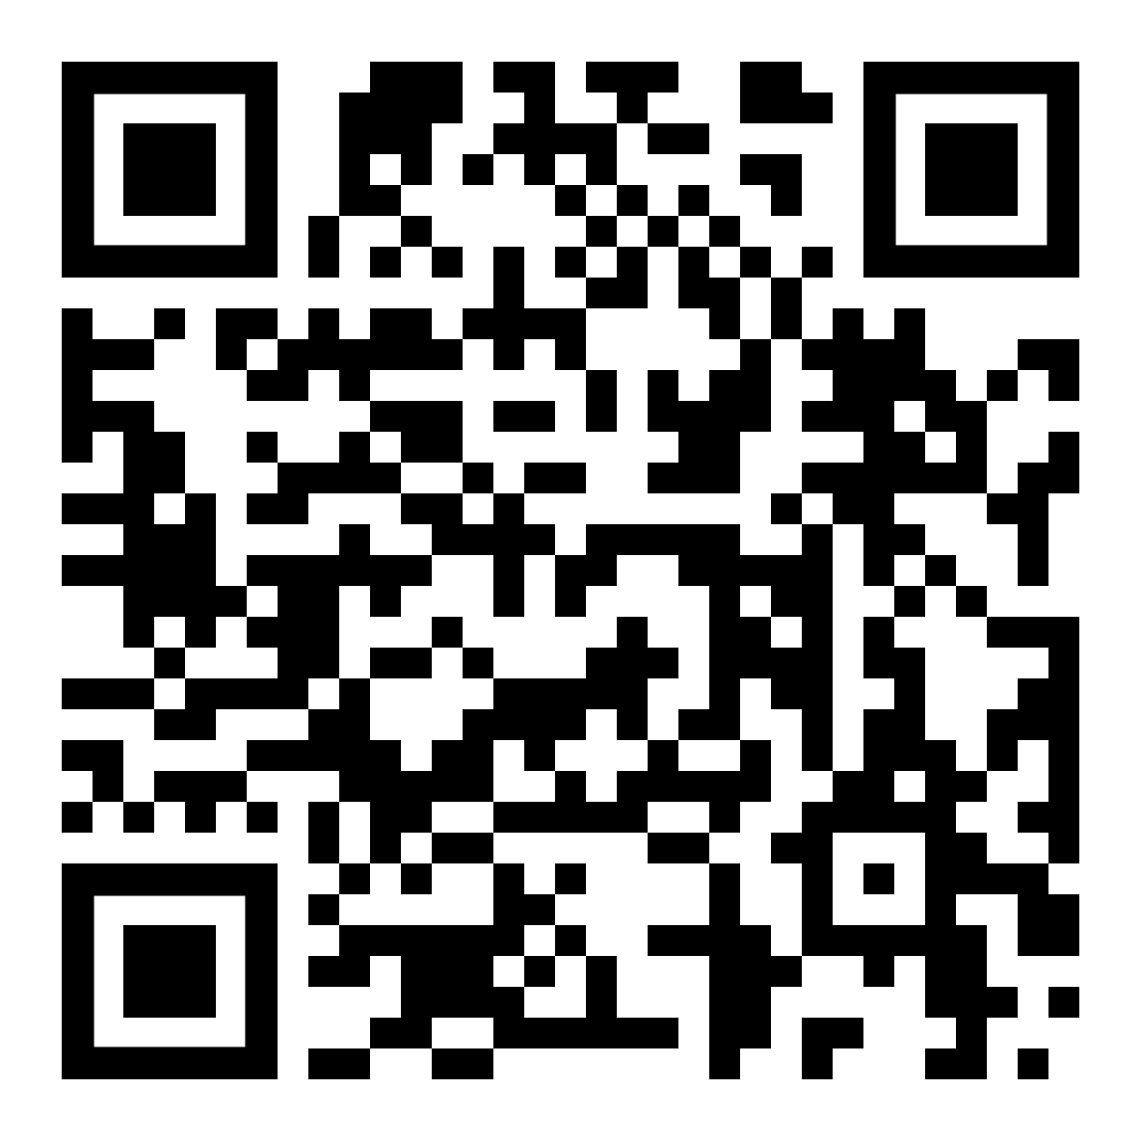
Council Popcorn Personnel
https://tidewaterbsa.com/2023popcornsale/
Council Popcorn Kernel
Erin Alford
erin@realresultsva.com
757-943-7226
Popcorn Staff Advisor
Alison Harrison
popcorn@twchelpdesk.raiseaticket.com
Popcorn Support Staff Advisor
Pam Samples
Pam.Samples@scouting.org
757-353-0609
Tidewater Council - Mary Jayne Breeden Council Service Center
1032 Heatherwood Drive, Virginia Beach, VA 23455
2024 Popcorn Sale - https://tidewaterbsa.com/2024popcornsale/

Slide 28
In Conclusion. . .
Amount of sales required is based off a working budget
https://www.scouting.org/programs/scouts-bsa/troop-resources/program-planning-tools/
Help unload shipment when you can
Hold a kickoff party
Start early
Manage your inventory
Diversify your selling strategy
Communicate, Communicate, Communicate

Slide 29
QUESTIONS?

