Slide 1
Welcome to Cub Scout Pack 374!

Slide 2
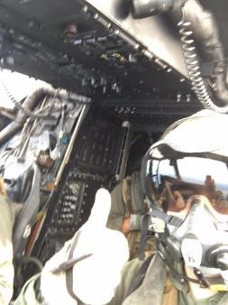
Jon Spencer (Our Big Kid)
Sorry I missed you all !!
In FL helping out this week!
I have a WEBELOS!
Asheville, NC
Started Tigers in….1986
Eagle Award 1998
NCSU 1999-2003
14 Years USMC Active Duty
2014 Committee / 2015 ACM / 2016 Cubmaster
I believe in this program & I’m pumped you’re here!

Slide 3
Den Leader Introductions (These people are Incredible!)

Slide 4
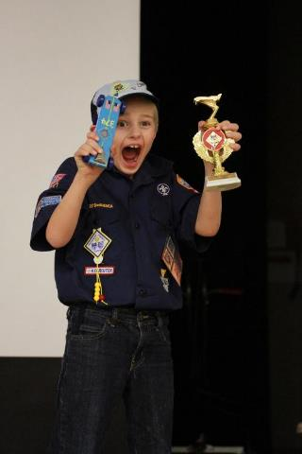
Things that Money Can’t Buy
The Purpose of Cub Scouting
Character development
Spiritual growth
Good citizenship
Sportsmanship and Fitness
Family understanding
Respectful relationships
Personal achievement
Friendly service
Preparation for Boy Scouts

Slide 5
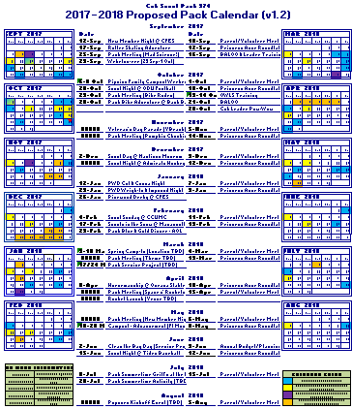
What are we doing this year ?
Fall Campout
Spring Campout
Spring Camp-In
Pumpkin Chunkin
Pinewood Derby
Rocket Derby
ODU Game
Admiral’s Game
Vet’s Day parade
Bike Rodeo
…and a whole lot more!

Slide 6
Volunteerism at its Best
Parents are the major source of Scout leadership
Scouting is designed to help even the busiest parent get involved
Parents should participate in and encourage their boys in their advancement
Allows you to teach by example and create a genuine impact—quality time with your son

Slide 7
Want to get involved?
Monthly parent & leader meetings held the first Sunday of the month at 3pm
CF Phase III Gazebo/Dave’s house
CCUMC Conference Room
Starbucks
Meeting plans, event plans, budgeting
The Pack pays for all leader training and materials

Slide 8
Folder Overview

Slide 9
The Join Process…
Step 1
Complete an online or paper application for your son at table 1. This is where you will fill out a leader application as well
Step 2
Hand your paperwork and fees in tonight at table 2. Purchase your son’s Pack t-shirt and hat
Step 3
Mingle with the Den Leaders!

Slide 10
Confused or need help?
If you have concerns regarding financial matters please contact the treasurer.
All financial matters are strictly confidential…and scholarships/assistance are available.
Scouting isn’t free, but financial concerns should never stand in the way of boys who want to engage in this program!!

Slide 11
Questions?

Slide 12
Slime!
Go see the gross stuff your kids have been making!

Slide 13
Cub Scout Organization
Dens are organized by Rank based on age
Ranks are…
Lion ( Kindergarten )
Tiger ( 1st grade )
Wolf ( 2nd grade )
Bear ( 3rd grade )
Webelos ( 4th grade )
Arrow of Light ( 5th grade )
All Scout Activities are age-appropriate

