Slide 1
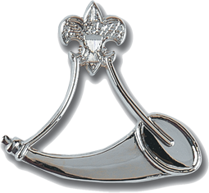
Tidewater Council Powder Horn Resource Guide

Slide 2
Astronomy
Fishing
Tidewater Council Powder Horn
Resource Guide
Backpacking
Geocaching
Camping
Hiking
Cave Exploring
Orienteering
Climbing/Rappelling
Outdoor Ethics/LNT
Conservation
Paddle Sports
C.O.P.E.
Sailing
Cycling/Mountain Biking
Scuba and/or Snorkeling
Ecology
Shooting Sports
Emergency Preparedness
Whitewater Rafting
Equestrian
Wilderness Survival
Adaptive Programs
Expedition Planning
Winter Sports

Slide 3
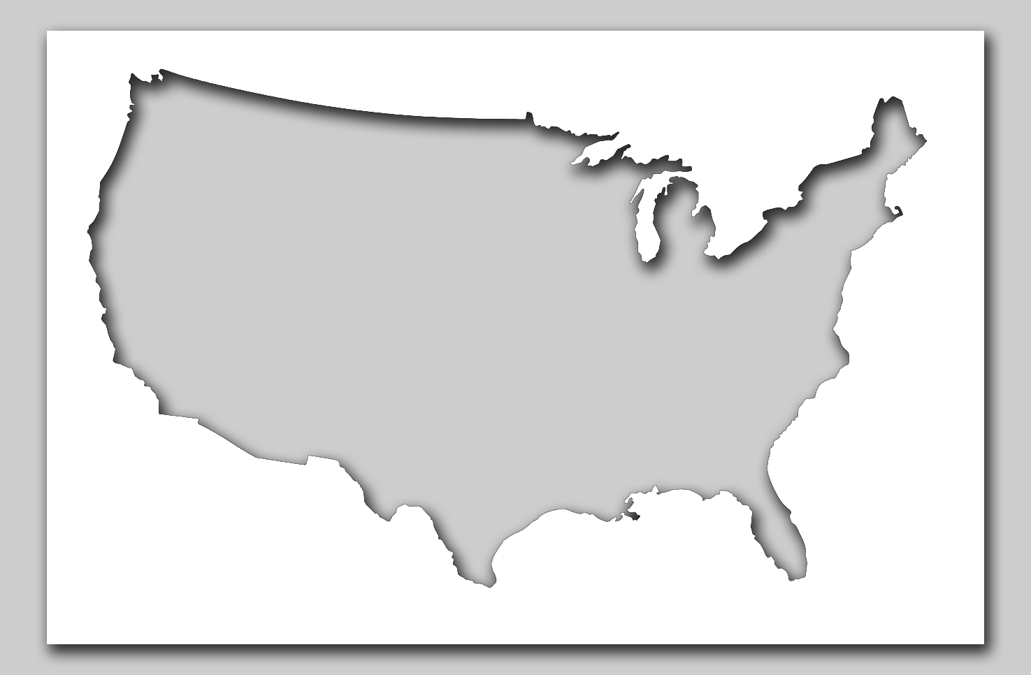
Astronomy
Back to Menu

Slide 4
Astronomy
Beazley Planetarium | Portsmouth, VA | http://childrensmuseumvirginia.com/beazley-planetarium/
Chesapeake Planetarium | Chesapeake, VA | https://cpschools.com/planetarium/
Green Bank Observatory | Green Bank, WV | https://greenbankobservatory.org/ -
List of Astronomy Clubs | Virginia-wide | https://skyandtelescope.org/astronomy-clubs- organizations/?title=Clubs+by+State&return_url=&tag=virginia
Norfolk Astronomical Society | Norfolk, VA | http://norfolkastronomical.org/
NSU Planetarium | Norfolk, VA | http://rrrtserver.nsu.edu/page4.html
Tidewater Community College Astronomical Society | Chesapeake, VA | https://skyandtelescope.org/clubs-organizations/tidewater-community-college-astronomical-society/
Virginia Beach Public Schools Planetarium | Virginia Beach, VA | http://www.planetarium.vbschools.com/
Back to Astronomy Map
Back to Menu

Slide 5
Backpacking
Back to Menu

Slide 6
Backpacking
American Hiking Society | Nation-wide | https://americanhiking.org/
Back Country Outdoor Leadership Skills | National Capital Area | https://www.ncacbsa.org/
Carolina Mountain Club | Asheville, NC | https://www.carolinamountainclub.org/
Friends of First Landing State Park | Virginia Beach, VA | https://friendsoffirstlandingstatepark.com/
Goshen Scout Reservation - Historic Trails | Goshen, VA | https://www.gotogoshen.org/
Great Outdoor Provisions | NC and VA | https://greatoutdoorprovision.com/
James River Outdoor Coalition | Richmond, VA | https://jroc.net/
Mt. Roger Outfitters | Damascus, VA | http://www.mtrogersoutfitters.com/hostshut.html
Prince William Trails and Streams Coalition | Prince William County, VA | http://www.pwtsc.org/
REI | Nation-wide | https://www.rei.com/stores/virginia-beach.html
Roanoke Outside | Roanoke, VA | https://www.roanokeoutside.com/
Rockfish Gap Outfitters | Waynesboro, VA | rockfishgapoutfitters.com
Tennessee Eastman Hiking and Canoeing Club | Kingsport, TN | http://tehcc.org/
The Trek | Nation-wide | https://thetrek.co/
Tidewater Appalachian Trail Club | Avenue, Norfolk, VA | https://tidewateratc.com/
Virginia Capital Trail Foundation | State-wide | https://www.virginiacapitaltrail.org/
Walkabout Outfitters | Richmond, VA | https://www.walkaboutoutfitter.com/
Wild River Outfitters | Virginia Beach, VA | https://www.wildriveroutfitters.com/
Wildland Trekking | Nation-wide | https://www.wildlandtrekking.com/
Back to Backpacking Map
Back to Menu

Slide 7
Camping
Back to Menu

Slide 8
Camping A-F
Albright Scout Reservation | Chesterfield County, VA | https://hovc.org/camping/albright/
Blue Cat on the New | Draper, VA | https://bluecatsnewriveroutfitters.com/
Camp Eagle Point | Mecklenburg County, VA | https://hovc.org/camping/eaglepoint/
Camp Karma | Bedford, VA | http://www.campkarmavirginia.com/
Camp Outback-Shenandoah River Outfitters | Luray VA | https://shenandoah-river.com/canoe-kayak-tube-raft-rentals/camping/
Chickahominy Riverfront Park | Williamsburg, VA | https://jamescitycountyva.gov/Facilities/Facility/Details/Chickahominy-Riverfront-Park-2
Crabtree Falls Campground | Tyro, VA | http://www.crabtreefallscampground.com/
Creative Guiding LLC | Hampton Roads, VA | http://www.creativeguiding.com
False Cape State Park | Virginia Beach, VA | https://www.dcr.virginia.gov/state-parks/false-cape
First Landing State Park Campground | Virginia Beach, VA | https://www.first-landing-state-park.org/first_landing_camping.html
Fort Boykin Historic Park | Smithfield, VA | https://www.virginia.org/listings/HistoricSites/FortBoykinHistoricPark/
Back to Camping Map
Back to Menu

Slide 9
Camping G-Z
Greenwood Point Campground | Hot Springs, VA | https://www.fs.usda.gov/recarea/gwj/recreation/hiking/recarea/?recid=73723&actid=29
Holiday Trav-L-Park | Virginia Beach, VA | https://www.campingvb.com/
Little Bennett Campground | Clarksburg, MD | https://www.montgomeryparks.org/parks-and-trails/little-bennett-regional-park/little-bennett-camping/
National Park-Blue Ridge Parkway | Blue Ridge Parkway, VA | https://www.nps.gov/blri/planyourvisit/camping.htm
Newport News Campground | Newport News, VA | https://www.nnva.gov/2340/Camping
North Creek Campground | Buchanan, VA | https://www.fs.usda.gov/recarea/gwj/recreation/camping-cabins/recarea/?recid=73857&actid=29
North Landing Beach Riverfront Campground and Resort | Virginia Beach, VA | https://northlandingbeach.com/
Northwest River Park | Chesapeake, VA | http://www.cityofchesapeake.net/government/City-Departments/Departments/parks-recreation-tourism/parks/nwrp_1.htm
Prince William Forest Park Oak Ridge Campground | Triangle, VA | http://www.campingroadtrip.com/campgrounds/campground/campground/17988/virginia/prince-william-forest-park-nps-oak-ridge
Sandy Bottom Nature Park | Hampton, VA | https://hampton.gov/992/What-To-Do
Back to Camping Map
Back to Menu

Slide 10
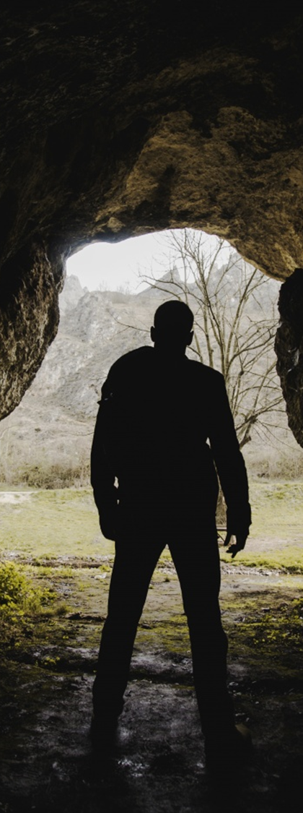
Cave Exploring
Back to Menu

Slide 11
Cave Exploring A - L
15 Incredible Caves | Nation-wide | https://www.travelzoo.com/blog/15-incredible-caves-explore-america/
Baltimore Grotto | Baltimore, MD | http://caves.org/grotto/baltimore/
Battlefield Area Troglodyte Society | Fredericksburg, VA | http://bats.caves.org/
Blue Ridge Grotto | Roanoke, VA | http://blueridgegrotto.org/
Butler Cave Conservation Society | Staunton, VA | http://www.butlercave.org/
Dixie Caverns | Salem, VA | https://www.dixiecaverns.com
Endless Caverns | New Market, VA | http://endlesscaverns.com
Front Royal Grotto | Front Royal, VA | http://frg.caves.org/about.html
Grand Caverns | Grottoes, VA | https://www.grandcaverns.com/
Lost World Caverns | Lewisburg, WV | https://www.lostworldcaverns.com/
Luray Caverns | Luray, VA | https://luraycaverns.com
National Caves Association Nation-wide https://cavern.com
Back to Cave Exploring Map
Back to Menu

Slide 12
Cave Exploring L-Z
Natural Bridge Caverns | Natural Bridge, VA | https://www.naturalbridgeva.com/caverns.html
Organ Cave | Organ Cave, WV | http://www.organcave.com/
Seneca Caverns | Riverton, WV | https://www.senecacaverns.com/
Shenandoah Caverns | Quicksburg, VA | https://shenandoahcaverns.com
Skyline Caverns | Front Royal, VA | https://skylinecaverns.com
Smoke Hole Caverns | Cabin, WV | https://www.smokehole.com/
VA Region of National Speleological Society | State-wide | http://var.caves.org/index.php/varmenu/grottosmenu
Walker Grotto | Marion, VA | https://walkergrotto.wordpress.com/
Back to Cave Exploring Map
Back to Menu

Slide 13
Climbing/Repelling
Back to Menu

Slide 14
Climbing/Repelling
ACE Adventure Resort | OAK HILL, WV 25901 | https://aceraft.com/adventures/adventures-on-land/ziplining/
Latitude climbing | Norfolk, VA | https://latitudeclimbing.com
NROCKS Outdoor Adventures | Circleville, WV | https://www.nrocks.com/
The Adventure Park at Virginia Aquarium | Virginia Beach, VA | https://www.virginiabeachadventurepark.com
Virginia Beach Rock Gym | Virginia Beach, VA | https://www.facebook.com/vbrockgym/
Back to Climbing/Repelling Map
Back to Menu

Slide 15
Conservation
Back to Menu

Slide 16
Conservation
Colonial Soil and Water Conservation District | Williamsburg, VA | https://www.colonialswcd.net/
Historic Virginia Land Conservancy | Williamsburg, VA | http://historicvirginialandconservancy.org/
Izaak Walton League of America | Gaithersburg, MD | https://www.iwla.org
James River Outdoor Coalition | State-wide | https://jroc.net/
Project AWARE | World-wide | https://www.projectaware.org/
Virginia Department of Game and Inland Fisheries | State-wide | https://www.dgif.virginia.gov/
Virginia Living Museum | Newport News, VA | https://thevlm.org/explore/conservation/
World-Wide Fund for Nature(WWF) | World-wide | https://www.worldwildlife.org/about
Back to Conservation Map
Back to Menu

Slide 17
Conservation - VA Beach
Back Bay National Wildlife Refuge | Virginia Beach, VA | https://www.facebook.com/backbaynwr/about/?ref=page_internal
Chesapeake Bay Foundation-Brock Environmental Center | Virginia Beach, VA | https://www.cbf.org/about-cbf/locations/virginia/facilities/brock-environmental-center/
Friends of First Landing State Park | Virginia Beach, VA | https://friendsoffirstlandingstatepark.com/
Friends of Indian River | Virginia Beach, VA | http://www.friendsofindianriver.org/
Lynnhaven River Now | Virginia Beach, VA | https://www.lynnhavenrivernow.org
VA Beach Storm Water Quality Program | Virginia Beach, VA | https://www.vbgov.com/government/departments/public-works/surface-water-regulation/Pages/public-education-and-outreach.aspx
Virginia Aquarium | Virginia Beach, VA | https://www.virginiaaquarium.com/conserve/Pages/Conservation-in-Action.aspx
Wildlife Response | Virginia Beach, VA | http://wildliferesponse.org/
Back to Conservation Map
Back to Menu

Slide 18
Conservation - Norfolk
Cape Henry Audubon Society | Norfolk, VA | http://www.chasnorfolk.org/
Elizabeth River Project | Norfolk, VA | https://elizabethriver.org/
Friends of Norfolk Environment | Norfolk, VA | http://www.foneonline.org
Tidewater Appalachian Trail Club | Norfolk, VA | https://www.tidewateratc.com/
Friends of Norfolk Environment | Norfolk, VA | http://www.foneonline.org
Back to Conservation Map
Back to Menu

Slide 19
Conservation - Chesapeake
Chesapeake Environment | Chesapeake, VA | http://www.cityofchesapeake.net/Residents/Chesapeake-s-Environment.htm
Izaak Walton League of America | Chesapeake, VA | https://www.iwla.org
Nature's Calling | Chesapeake, VA | https://www.facebook.com/VAnaturescalling/
Back to Conservation Map
Back to Menu

Slide 20
C.O.P.E
Back to Menu

Slide 21
C.O.P.E.
Boulderline | Lake Lure, NC | http://boulderlinezip.com/
First Flight Adventure Park | Nags Head, NC | https://www.firstflightadventurepark.com/
Fun Spot | Hartwell, GA | https://www.funspot.com/
Go Ape | Williamsburg, VA | https://www.goape.com/
Highlands Aerial Park | Scaly Mountain, NC | https://www.highlandsaerialpark.com/
Mega Cavern | Louisville, KY | https://louisvillemegacavern.com/
Navitat | Ashville, NC | https://navitat.com/asheville-nc/
River Rides Adventure Park | Harpers Ferry, WV | https://www.riverriders.com/
Sandy River Outdoor Adventures | Rice, VA | https://www.sandyriveroutdooradventures.com/
Summit Ropes | Sterling, VA | https://www.summitropes.com/
Terrapin Adventures | Savage, MD | https://www.terrapinadventures.com/
The Adventure Park | Virginia Beach, VA | https://myadventurepark.com/location/virginia-beach-va/
The Edge | Manassas, VA | https://edge.gmu.edu/
Treetop Zoofari | Richmond, VA | http://treetopzoofari.com/
Back to Cope Map
Back to Menu

Slide 22
Cycling/Mountain Biking
Back to Menu

Slide 23
Cycling/Mountain Biking
Biking in Virginia | State-wide | https://www.virginia.org/cycling/
Carolina Tailwinds | State-wide | https://www.carolinatailwinds.com/virginia
Conte's Bike Shop | Virginia Beach, VA | https://www.contebikes.com/about/virginia-beach-va-pg241.htm
Cycling VA | State-wide | https://www.cyclingva.com/
East Coast Bicycling | Norfolk, VA | https://www.eastcoastbicycles.com/
Fat Frogs Bike & Fitness | Virginia Beach, VA | https://fatfrogsbikes.com/
Mountain Biking in Virginia | State-wide | https://www.virginia.org/mountainbiking/
REI | World-wide | https://www.rei.com/adventures/a/cycling
Road-tested Bike Tours | Nation-wide | https://roadtestedbiketours.com/
Virginia Capital Trail | Richmond, VA | https://www.virginiacapitaltrail.org/shop-gear/cycling-adventures-along-the-virginia-capital-trail
Back to Cycling/Mountain Biking Map
Back to Menu

Slide 24
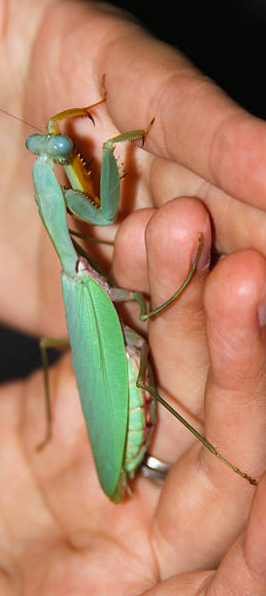
Ecology
Back to Menu

Slide 25
Ecology
Hog Island Wildlife Management Area | Surry, VA | https://dwr.virginia.gov/wma/hog-island/
Network for Endangered Sea Turtles | Outer Banks, NC | http://www.nestonline.org/become-a-volunteer/
Norfolk Botanical Garden | Norfolk, VA | https://norfolkbotanicalgarden.org/support/volunteer/
Virginia Aquarium & Marine Science Center | Virginia Beach, VA | http://www.virginiaaquarium.com/
Back to Ecology Map
Back to Menu

Slide 26
Emergency Preparedness
Back to Menu

Slide 27
Emergency Preparedness
American Red Cross | Nation-wide | http://www.redcross.org
American Safety and Health Institute | Nation-wide | https://emergencycare.hsi.com/
CARES | Chesapeake, VA | https://w4car.org/public-service/chesapeake-amateur-radio-emergency-services-cares/
Centers for Disease Control and Prevention | Nation-wide | http://www.cdc.gov
Federal Emergency Management Agency (FEMA) | Nation-wide | http://www.fema.gov
National Safety Council | Nation-wide | http://www.nsc.org
Pet information | Nation-wide | www.artanimals.org
STOP THE BLEED | Nation-wide | http://www.stopthebleed.org
VB ARES | Virginia Beach, VA | https://www.w4ug.com/ARES.htm
Virginia Beach EMS | Virginia Beach, VA | www.vbems.com
Virginia Department of Emergency Management | State-wide | https://www.vaemergency.gov/
Back to Emergency Preparedness Map
Back to Menu

Slide 28
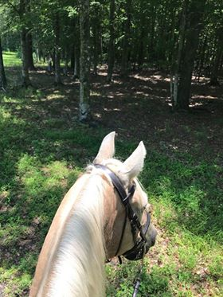
Equestrian
Back to Menu

Slide 29
Equestrian
Bailey's Walking After Midnight Farm | Cross Junction, VA | https://walking-after-midnight.com/
Easy Does It Riding Academy | Chesapeake, VA | http://www.easydoesitranch.net/index.html
Silver Eagle Stable | Nokesville, VA | https://sestable.com/
Virginia Beach | (OBX) Horseback | Virginia Beach, VA | https://www.virginiabeachhorseback.com/
Back to Equestrian Map
Back to Menu

Slide 30
Expedition Planning
Back to Menu

Slide 31
Expedition Planning
BSA High Adventure Bases | BSA Nation-wide | https://www.scouting.org/careers/employment-opportunities/high-adventure-bases/
BSA Historic Trails | BSA Nation-wide | https://tap.scouting.org/historic-trails/
BSA Outdoor Programs Committee Guide | BSA Nation-wide | https://filestore.scouting.org/filestore/Outdoor%20Program/pdf/430-935_WEB.pdf
BSA Passport to High Adventure | BSA Nation-wide | https://filestore.scouting.org/filestore/pdf/passport_to_highadventure_34245(16).pdf
BSA Philmont Expedition Trek Planning | New Mexico | https://www.philmontscoutranch.org/philmonttreks/expeditions/
BSA Trek Planning | BSA Nation-wide | https://filestore.scouting.org/filestore/Outdoor%20Program/pdf/430-125_WB.pdf
Guide to Safe Scouting | BSA Nation-wide | https://www.scouting.org/health-and-safety/gss/toc/
High Adventure for Scouts and Scouters | BSA Nation-wide | https://www.highadventurescouting.com/
The Adventure Plan | BSA Nation-wide | https://tap.scouting.org/
Back to Expedition Planning Map
Back to Menu

Slide 32
Fishing
Back to Menu

Slide 33
Fishing
Bob’s Fishing Hole | Chesapeake, VA | https://bobsfishinghole.com/Home_Page.php
Chesapeake Bay Sport Fishing | Stevensville, MD | http://ChesapeakeBaySportFishing.com
Dad's Fishing Spot Catfish Paylake | Flat Gap, KY | https://www.facebook.com/DadsFishingSpotCatfishPaylake/about/?ref=page_internal
Great Bridge Lock Park | Chesapeake, VA | http://www.cityofchesapeake.net/government/City-Departments/Departments/parks-recreation-tourism/parks/greatbridgelockpark.htm
Hampton Roads Charter | Fort Monroe, VA | https://www.hamptonroadscharter.com/
Hampton Roads Fishing | Hampton Roads | https://www.facebook.com/Fishingvbwaters
Little Island Park and Fishing Pier | Virginia Beach, VA | http://www.vbgov.com/government/departments/parks-recreation/parks-trails/city-parks/Pages/little-island-park.aspx
Lynnhaven Fishing Pier | Virginia Beach, VA | http://www.lynnhavenfishingpier.com/
Virginia Beach Fishing Center | Virginia Beach, VA | https://www.virginiafishing.com/
Virginia Beach Fishing Pier | Virginia Beach, VA | http://vabeachfishingpier.com/
Back to Fishing Map
Back to Menu

Slide 34
Geocaching
Back to Menu

Slide 35
Geocaching
Geocaching App | World-wide | https://www.geocaching.com/play
Geocaching Hampton Roads | Hampton Roads, VA | https://www.facebook.com/groups/geocachinghamptonroads/
SNAP!!! Geocaching | Blog | https://www.snapgeocaching.com/p/top-10-caches-in-virginia-beach.html
Virginia Geocaching Trails and Maps | State-wide | https://www.traillink.com/stateactivity/va-geocaching-trails/
Virginia State Parks | State-wide | https://www.dcr.virginia.gov/state-parks/geocaching-game
Back to Geocaching Map
Back to Menu

Slide 36
Hiking
Back to Menu

Slide 37
Hiking
BSA Historic Trails | BSA Nation-wide | https://tap.scouting.org/historic-trails/
US Forest Service | Nation-wide | https://www.fs.usda.gov/visit/maps
Find your beach Nation-wide https:www.adventureawaits.com
Back to Hiking Map
Back to Menu

Slide 38
Orienteering
Back to Menu

Slide 39
Orienteering
Quantico Orienteering Club | Nation-wide | https://www.qocweb.org/content/our-venues-and-maps?sort=desc&order=State
Blue Ridge Orienteering Club | Blue Ridge Mountains | https://www.blueridgeorienteering.org/about.php
Orienteering USA | Nation-wide | https://orienteeringusa.org/
Prince William Forest | Triangle, VA | https://www.nps.gov/prwi/planyourvisit/orienteering.htm
Quantico Orienteering Club | Quantico, VA | https://www.qocweb.org/
REI-Basic Info Article | Nation-wide | https://www.rei.com/learn/expert-advice/orienteering-basics.html
Windsor Castle Park | Smithfield, VA | http://www.windsorcastlepark.com/compass-course.html
Back to Orienteering Map
Back to Menu

Slide 40
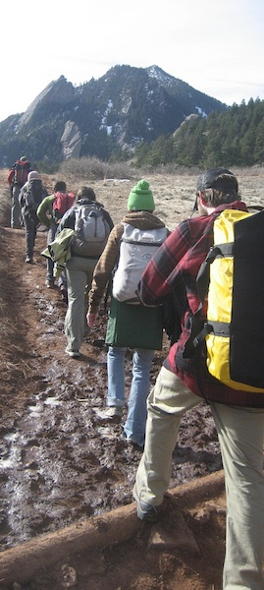
Outdoor Ethics/LNT
Back to Menu

Slide 41
Outdoor Ethics/LNT
BSA Outdoor Ethics Awards | Nation-wide | https://www.scouting.org/outdoor-programs/outdoor-ethics/
BSA Outdoor Ethics Resources | Nation-wide | http://outdoorethics-bsa.org/
Leave No Trace | Boulder, CO | https://lnt.org/
Tidewater Master Naturalist | Hampton Roads,VA | https://tidewatermn.org/
Back to Outdoor Ethics/LNT Map
Back to Menu

Slide 42
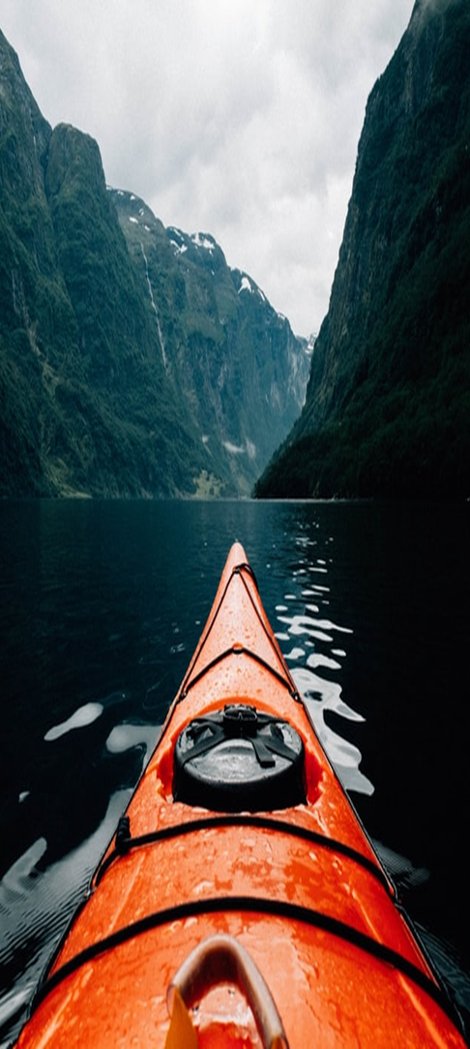
Paddle Sports
Back to Menu

Slide 43
Paddle Sports
American Canoe Association | Fredericksburg, VA | https://www.americancanoe.org/
Blue Ridge Voyageurs | Md Atlantic Area | http://www.blueridgevoyageurs.org/
Carolina Canoe Club | Raleigh, NC | https://www.carolinacanoeclub.org/
Coastal Canoeists | Richmond, VA | https://www.coastals.org/
Kayak Enthusiasts of Hampton Roads VA & North Eastern NC | Hampton Roads VA | https://www.facebook.com/groups/183064152272917/
Kayak Nature Tours | Virginia Beach, VA | https://www.kayaknaturetours.net/
Ocean Eagle Kayaking | Virginia Beach, VA | https://www.oceaneaglekayak.com/
Penguin Paddling | Occoquan, VA | https://www.penguinpaddling.com/
Potomac Paddle sports | Potomac, MD | https://www.potomacpaddlesports.com/
RVA Paddles Sports | Richmond, VA | https://rvapaddlesports.com/
Shenandoah River Outfitters | Luray, VA | https://shenandoah-river.com/
Surf & Adventure Co. | Virginia Beach, VA | https://oceanrentalsltd.com/
Tula Adventure Sports | Virginia Beach, VA | https://www.tulasports.com
Twin River Outfitters | Buchanan, VA | https://canoevirginia.net/
Wild River Outfitters | Virginia Beach, VA | https://www.wildriveroutfitters.com/
Wildriver Outfitter | Virginia Beach, VA | https://www.wildriveroutfitters.com/
Back to Paddle Sports Map
Back to Menu

Slide 44
Sailing
Back to Menu

Slide 45
Sailing
American Sailing Association | Nation-wide | https://asa.com/
BSA Sea Base | Nation-wide | https://www.bsaseabase.org/
DELMARVA Council | Dover DE | https://www.delmarvacouncil.org/high-adventure-opportunities/high-adventure-sailing-on-the-chesapeake/9297
Norfolk Naval Sailing Center | Norfolk, VA | https://www.navymwrnavalstationnorfolk.com/recreation/marina
Pamlico Sea Base - Eastern Carolina Council | Kinston, NC | https://www.eccbsa.org/camping/pamlico-sea-base/
Sail Hampton Roads (Tidewater Council) | Hamton Roads | https://tidewaterbsa.com/
Sail Nauticus | Norfolk, VA | https://sailnauticus.org/
Sail Time Virginia Beach | Virginia Beach, VA | https://sailtime.com/
Sea Scout Ship 42 | Hampton Roads | https://www.facebook.com/groups/Ship42TWC/
US Sailing | Nation-wide | https://www.ussailing.org/
Youth Sailing Virginia | Hampton, VA | https://youthsailingva.org/
Back to Sailing Map
Back to Menu

Slide 46
Scuba
Back to Menu

Slide 47
SCUBA
Allstar Live Boards-Scouts | Fort Walton Beach, FL | https://allstarliveaboards.com/scuba-diving-scouts/
Blue Octopus | Alexandria, VA | https://www.blueoctopusscuba.com/
Chesapeake Bay Diving | Virginia Beach, VA | https://www.cbdiving.com
Discovery Diving Company | Beaufort, NC | https://www.discoverydiving.com/
Grand Adventure Charters L.L.C. | Virginia Beach, VA | www.grandadventurevb.com
Lake Phoenix | Rawlings, VA | www.lake-phoenix.com
Lynnhaven Dive Center | Virginia Beach, VA | https://ldcscuba.com
Malibu Divers-Scouting | Malibu, CA | https://malibudivers.com/collections/bsa-boy-scout-scuba-programs
Olympus Dive Center (ODC) | Morehead City, NC | www.olympusdiving.com
Scuba Commander | Norfolk, VA | https://www.scuba-commander.com/
Scuba board | World-wide | https://www.scubaboard.com/community/threads/hampton-roads-divers.536885/
Underwater Adventures | Hampton, VA | https://www.underwateradventures.com/
Virginia Scuba | Manassas, VA | https://www.virginiascuba.com/
Back to SCUBA Map
Back to Menu

Slide 48
Shooting Sports
Back to Menu

Slide 49
Shooting Sports
Bob's Gun Shop | Norfolk, VA | http://www.bobsgunshop.com/
C2 Shooting Center | Virginia Beach, VA | https://c2shootingcenter.com/
Freedom Shooting Center | Virginia Beach, VA | https://freedomshootingcenter.com/
Middlesex Shooting Sports Club | Hartfield, VA | http://www.middlesex-range.org/
NAS Oceana - Skeet, Trap & Archery Range | Virginia Beach, VA | https://www.navymwroceanadamneck.com/programs/b89a6e2b-8c55-4a82-be79-91d1543ff84e
Norfolk County Rifle Range | Chesapeake, VA | https://www.ncrr.net/
Smoking Gun Range | Colonial Heights, VA | http://www.thesmokinggunrange.com/SmokingGun.html
Step Outside | Hampton, VA | https://stepoutside.org/hampton-va/shooting-sports/
Superior Pawn and Gold | Hampton, VA | https://www.superiorpawnva.com/
Tactical Shooting Academy | Surry, VA | http://www.tacticalshooting.com/
Back to Shooting Sports Map
Back to Menu

Slide 50
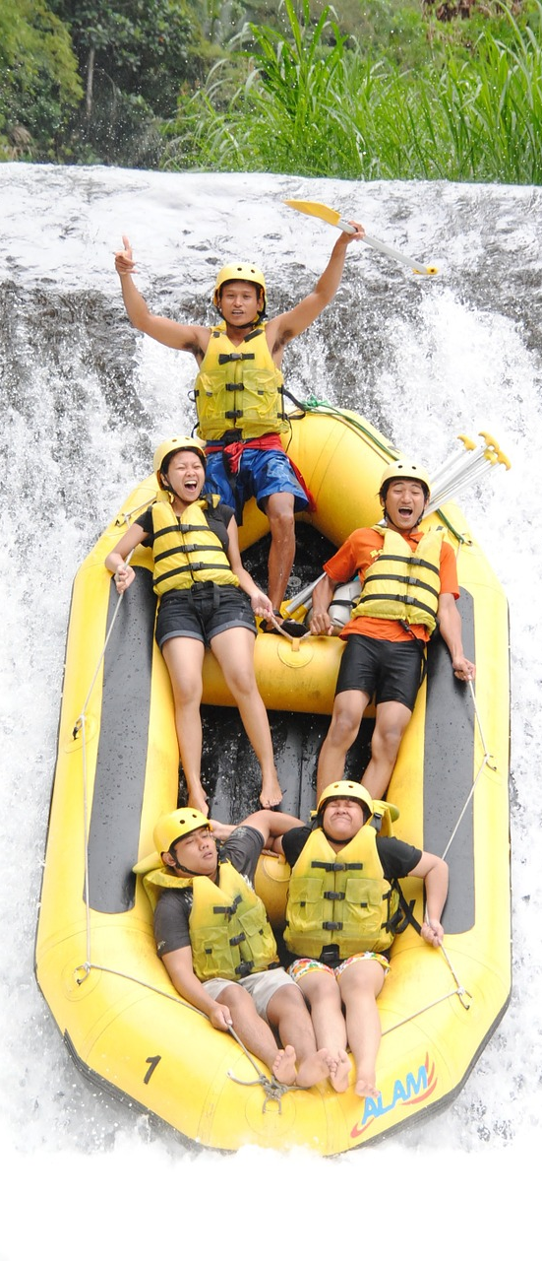
White Water Rafting
Back to Menu

Slide 51
Whitewater Rafting
ACE Adventure Resort | Oak Hill, WV | https://aceraft.com/white-water-rafting/
Adventures On the Gorge | Lansing, WV | https://www.adventuresonthegorge.com/
Carolina Outfitters Rafting | Topton, NC | http://carolinaoutfitters.com/
Fieldcraft Survival | Nation-wide | https://fieldcraftsurvival.com/
James River Runner | Scottsville, VA | http://jamesriver.com/
National Whitewater Center | Charlotte, NC | https://usnwc.org/
New & Gauley River Adventures | Lansing, WV | https://www.gauley.com/
Reeling and Rafting | Scottsville, VA | https://www.reelingandrafting.com/
River Expeditions | Oak Hill, WV | https://raftinginfo.com/adventures/white-water-rafting-west-virginia/
Riverside Outfitters | Richmond, VA | https://www.riversideoutfitters.com/
Back to Whitewater Rafting Map
Back to Menu

Slide 52
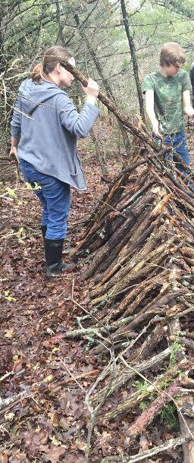
Wilderness Survival
Back to Menu

Slide 53
Wilderness Survival
Riverside Outfitters Richmond, VA https://www.riversideoutfitters.com/
Back to Wilderness Survival Map
Back to Menu

Slide 54
Winter Sports
Back to Menu

Slide 55
Winter Sports
High Adventure @ BSA Northern Tier | Ely, MN | https://www.ntier.org/about/winter-adventures/
Liberty Mountain Snowflex Centre | Lynchburg, VA | https://www.liberty.edu/campusrec/snowflex/
Massanutten Ski Lodge | Massanutten, VA | https://www.massresort.com/
Ski World-Virginia Beach | Virginia Beach, VA | https://www.skiworldinc.com
Wintergreen Resort | Nellysford, VA | https://www.wintergreenresort.com/
Back to Winter Sports Map
Back to Menu

Slide 56
Adaptive Programs
Back to Menu

Slide 57
Adaptive Programs
Accessible Virginia State-wide https://www.virginia.org/disabilityguide/
Access North Carolina State-wide
https://www.ncdhhs.gov/documents/access-north-carolina-vacation-and-travel-guide-people-disabilities
Back to Adaptive Programs Map
Back to Menu

